Slide 1
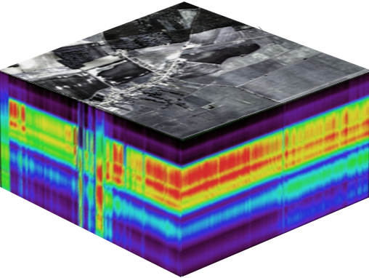
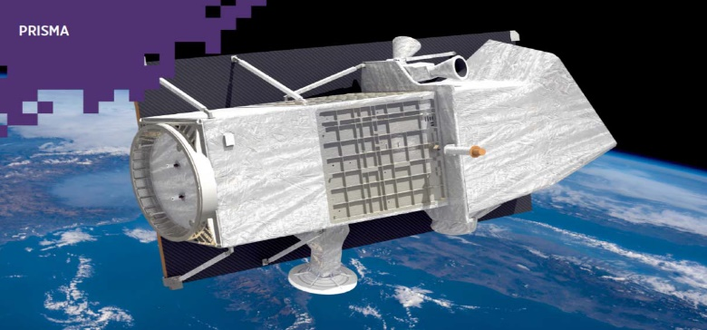
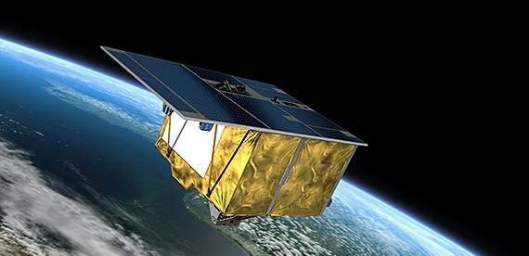
MENVIPRO Summer school - Tblisi/on-line, 11/07/2022
Hyperspectral remote sensing for vegetation and soil monitoring: opportunities from new generation spaceborne sensors
Prof. RAFFAELE CASA
Dipartimento di Scienze Agrarie e Forestali (Dafne),
Università degli Studi della Tuscia (Viterbo)
rcasa@unitus.it

Slide 2
Definition of imaging spectroscopy
Spectroscopy is the study of the interaction between matter and radiated energy specifically looking at what wavelengths of light are emitted or absorbed by an object in order to characterize materials.
Imaging spectroscopy (or hyperspectral remote sensing) refers to airborne or spaceborne imaging spectrometers measuring the spectrum of solar radiation reflected by earth surface materials in many contiguous wavebands.
Notes:
In spectroscopy - as well as in optical remote sensing - the intensity of electromagnetic radiation absorbed, reflected, transmitted or emitted from a surface is measured as a function of wavelength. The continuously recorded signal, also known as spectrum or spectral signature, contains information on physical processes that took place during data acquisition and allows the qualitative and quantitative characterization of materials

Slide 3
Electromagnetic radiation (I)
All electromagnetic radiation behaves in predictable ways and has fundamental properties
Components include a sinusoidal electrical wave (E) that varies in magnitude and a similar magnetic wave (M) at right angles, both being perpendicular to the direction of propagation. Both waves travel at the speed of light (c)
Electric field
(E)
Magnetic field
(M)
Velocity of light
(c)
adapted from Jensen 2007 and Lillesand et al. 2008

Slide 4
Electromagnetic radiation (II)
The characteristics of electromagnetic radiation that are particularly important for understanding remote sensing are wavelength and frequency:
Wavelength (λ) corresponds to the distance between successive wave crests (= length of one wave cycle). In imaging spectroscopy, it is most commonly measured in nanometres (nm, 10-9 m) or micrometres (μm, 10-6 m).
Frequency (u ) corresponds to the number of wave cycles passing a fixed point per unit time. It is usually measured in hertz (Hz).
Wavelength and frequency are inversely proportional: c = λ * u
λ
Lower frequency (υ )
→ Longer wavelength (λ)
λ
λ
Higher frequency (υ )
→ Shorter wavelength (λ)

Slide 5
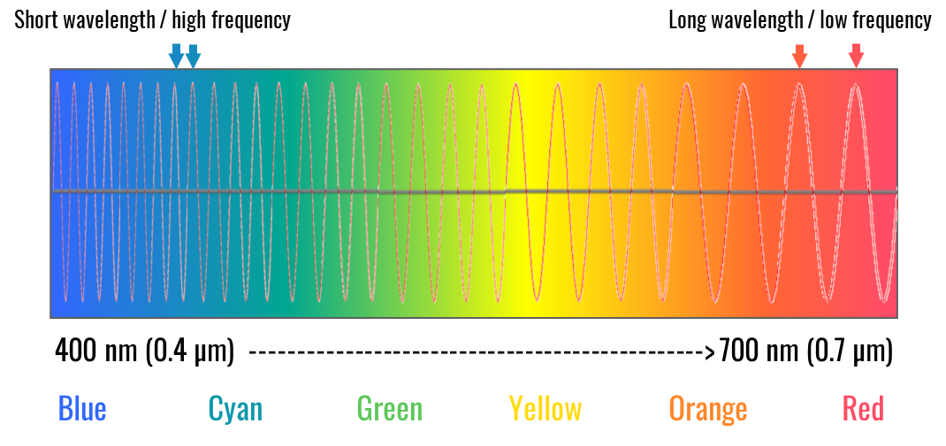
Electromagnetic radiation (III)
Notes:
In remote sensing, a certain range of the electromagnetic spectrum is often specified (e.g. red light) by defining an initial and final wavelength (or frequency). This wavelength is then called "band", "channel" or "region” (Jensen, 2007)

Slide 6
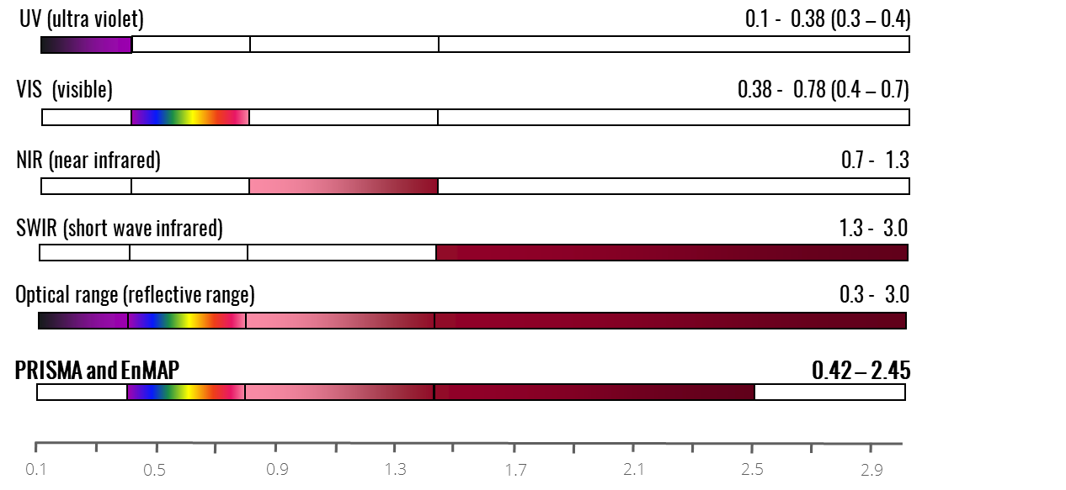
Wavebands and terminology
Notes:
The electromagnetic spectrum can be divided into several ranges (or wavebands), starting at very short wavelengths (high frequencies) with the X-rays in the range of approximately 0.01 µm, followed by ultraviolet radiation (UV) with wavelengths of 0.1 – 0.3 µm (1-10-6m). The range of light visible to humans (VIS) ranges from 0.38 to 0.78 µm and includes the colors violet, blue, green, yellow to orange and red. The visible spectrum is followed by infrared wavelengths (IR), divided into near infrared (NIR), short wave infrared (SWIR), mid infrared (MIR) and thermal infrared (TIR) that are followed by long wavelengths such as microwaves and radio waves.
This figure represents the definition of wavelength ranges that is commonly used in (optical) remote sensing. There are other definitions, e.g. in spectroscopy (from Clark 1999: ultraviolet (UV): 0.001 to 0.4 µm, visible: 0.4 to 0.7 µm, near-infrared (NIR): 0.7 to 3.0 µm, mid- infrared (MIR): 3.0 to 30 µm, and far infrared (FIR): 30 µm to 1 mm)

Slide 7
Basic laws of radiation (I)
Notes:
Radiation laws are important to understand how the radiation emanating from each object depends on its temperature and material properties:
The dependence of emitted radiation on the temperature follows the Stefan-Boltzmann law. The radiation is emitted in form of electromagnetic waves, whereas its intensity is a function of wavelength. The emission maximum of the temperature radiation is explained by Wien's displacement law, the form of the entire spectrum is described by Planck's law, and the interdependence of emissivity and absorbency of radiation is given by Kirchhoff's law.

Slide 8
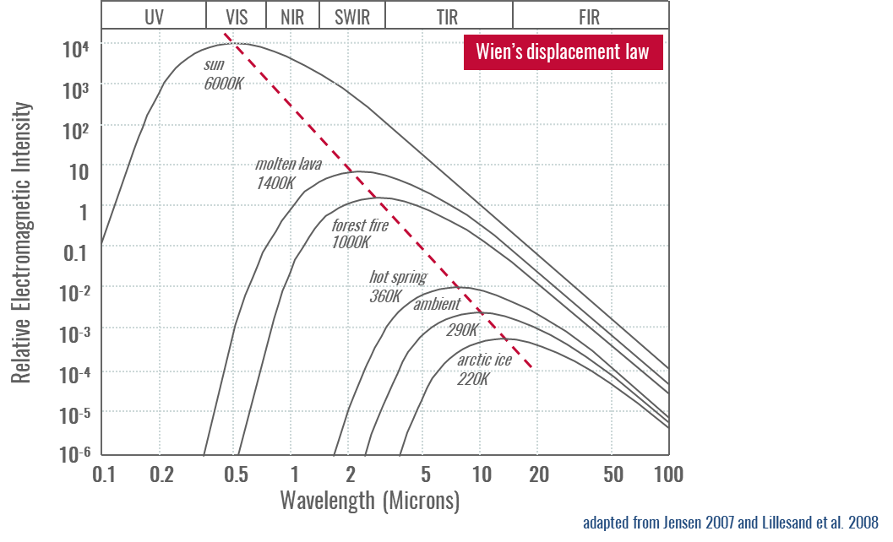
Blackbody radiation
All objects, at whatever temperature, emit radiant energy
Hotter objects radiate more total energy per unit area than colder objects
The surface temperature of the sun is about 6.000 K, while that of the Earth is 288 K (average). The sun emits about 160.000 times more energy than the Earth
The hotter the radiant body, the shorter the wavelength of maximum radiation
Perfect absorbers (perfect emitters) are called black bodies
Notes:
Wien’s displacement law indicates that higher temperatures correspond to a maximum intensity at shorter wavelengths and lower temperatures to a maximum intensity at higher wavelengths. The sun with its high surface temperatures of about 6000 K emits light with a maximum intensity of about 0.5 µm (visible range). The earth with an average surface temperature of 300 K emits light predominantly in the mid infrared with a maximum around 10 µm (also called thermal infrared).

Slide 9
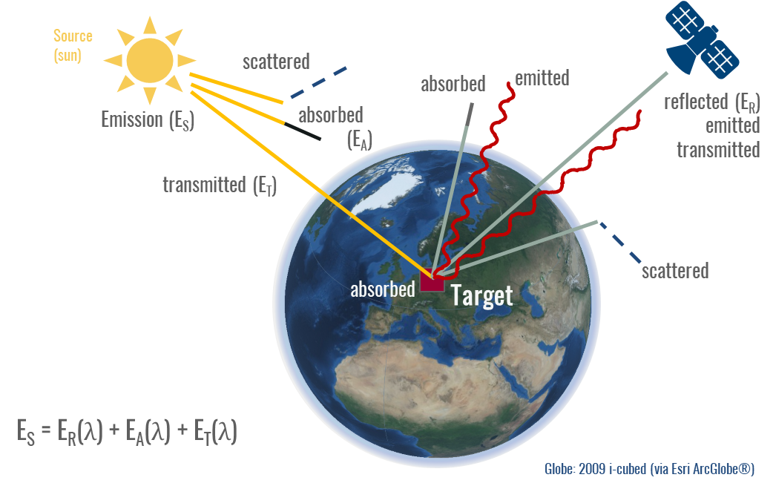
Radiation transfer (I)
Notes:
Radiation is influenced by the atmosphere in various ways: Extraterrestrial radiation reaching the Earth first enters the upper layers of the atmosphere, where part of it is reflected back into space. The other part travels through the atmosphere and is subject to various wavelength-dependent processes. For example, radiation is absorbed and scattered by gaseous and particulate components (e.g. water vapour, ozone, carbon dioxide, nitrogen and oxygen, as well as aerosols). This process is called extinction. In certain wavelength ranges, the atmosphere absorbs so intensely that very little or even no radiation reaches the Earth's surface. Wavelength ranges of the spectrum that are mostly permeable to radiation are called atmospheric windows. Remote sensing applications must consider two essential aspects, (1) the main sources of radiation (sun and Earth) and (2) the atmospheric windows.

Slide 10
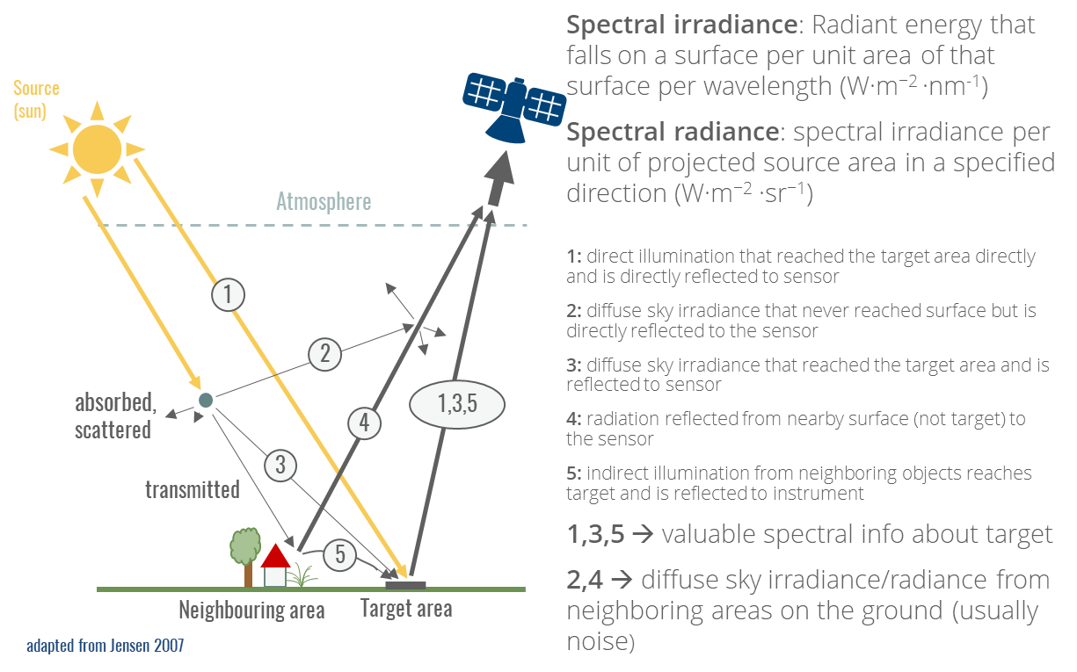
Radiation transfer (II)
Notes:
The dominant irradiance is direct illumination (approx. 90%, depending on atmospheric conditions). In addition, there is diffuse sky irradiance due to scattering and absorption in the atmosphere. One of the effects of diffuse sky irradiance is that the sky is blue and shadow areas are not completely dark, even without direct irradiation. Another effect is the spherical albedo of the atmosphere. It describes the part of radiation that is reflected back from the atmosphere to the observed object after it has been previously illuminated by reflected radiation (direct and diffuse) from the object. All the reflected radiation from the object has to pass through the atmosphere again along the path to the sensor and is thereby attenuated.
In addition to the radiation coming from the observed object, the so-called path radiance reaches the sensor. The path radiance is the part of the diffuse sky radiation that acts in the direction of the sensor. It is determined by the scattering processes within the atmosphere and is strongly wavelength-dependent. The path radiance leads to attenuation of the signals measured by the sensor.
So ideally, the signal recorded by the sensor is a true function of the amount of radiance leaving the target within the instanteneous-field-of-view at a specific solid angle. In reality, orther radiant energy may enter into the sensor‘s field of view from various other paths and introduce confounding noise (Jensen 2007).

Slide 11
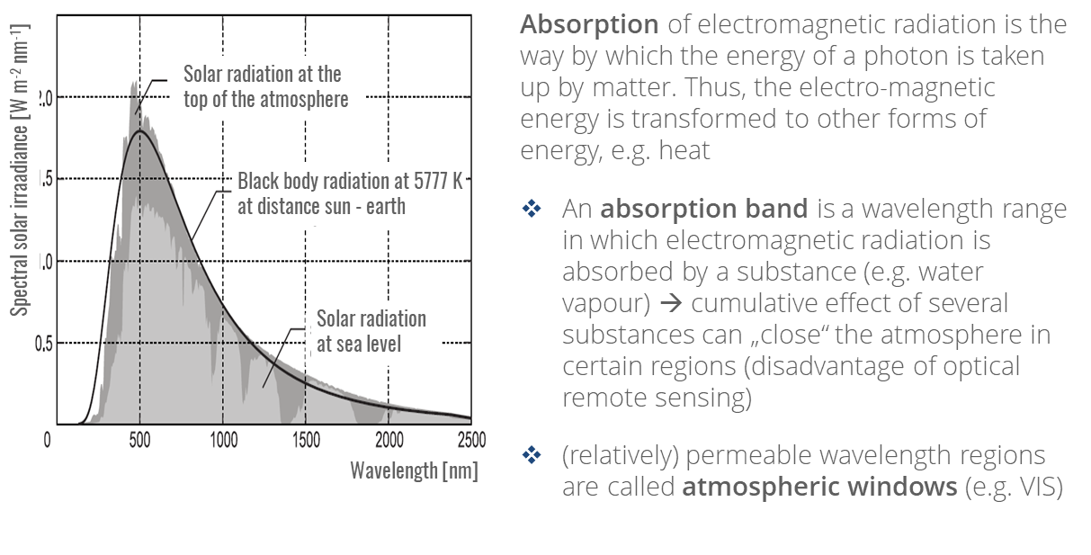
Interaction radiation – atmosphere (I)
Notes:
The extraterrestrial radiation arriving at Earth first reaches the upper layers of the atmosphere, where a part of it is reflected back into space. The other part travels through the atmosphere and is subject to various wavelength-dependent processes. Depending on the concentration, the radiation is absorbed and scattered by the gaseous and particulate components (e.g. nitrogen, oxygen, water vapor, ozone, carbon dioxide and aerosols). This process of radiation attenuation within the atmosphere is also called extinction, quantified by the transmittance of the atmosphere along the radiation path. In certain wavelength ranges, the atmosphere absorbs so strongly that very little or no radiation reaches the earth's surface. In remote sensing, therefore, only the so-called atmospheric windows are used, i.e. the wavelength ranges of the spectrum that are largely transparent to the radiation. In contrast to scattering, absorption is an effective energy loss of the radiation and is mainly caused by water vapor, carbon dioxide and ozone.

Slide 12
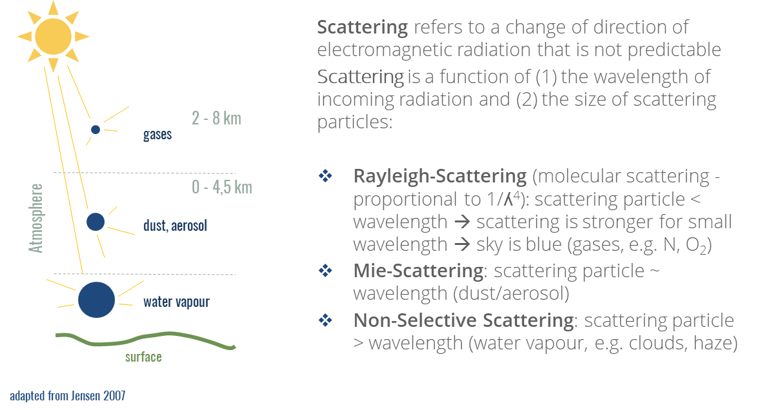
Interaction radiation – atmosphere (II)
Notes:
Atmospheric scattering describes the scattering of radiation in the atmosphere due to particles. Thereby, scattering refers to a change of direction of electromagnetic radiation that is not predictable (unlike reflectance). Scattering is a function of (1) the wavelength of incoming radiation and (2) the size of scattering particles:
Rayleigh scattering refers to diffuse scattering of electromagnetic waves by tiny particles or molecules (such as nitrogen or oxygen) whose diameter is much smaller than the wavelength (usually < 0.1 times smaller than the wavelength of the incident radiation). Rayleigh scattering usually occurs at an altitude of 2-8 km. Since the scattering stronger the shorter the wavelength (e.g. blue light), the Rayleigh scattering is responsible for the sky appearing blue.
Mie scattering is caused by particles in the atmosphere whose diameter is larger than the wavelength of the incident radiation (usually by 0.1-10 times), thus longer wavelengths are affected. It occurs mostly in the lower 4.5 km of the atmosphere. Particles causing Mie absorption include aerosols (sea salt, dust, biologicals, sulfates, nitrates, etc. resulting from evaporation, industrial pollutions, (forest) fires, and volcanic eruptions)
Non-selective scattering is caused by water vapor (drops) or ice particles, that are > 10 times as large as the wavelength of the incident radiation and scatters all wavelengths equally well. It occurs closest to the Earth’s surface
(Jensen, 2007)

Slide 13
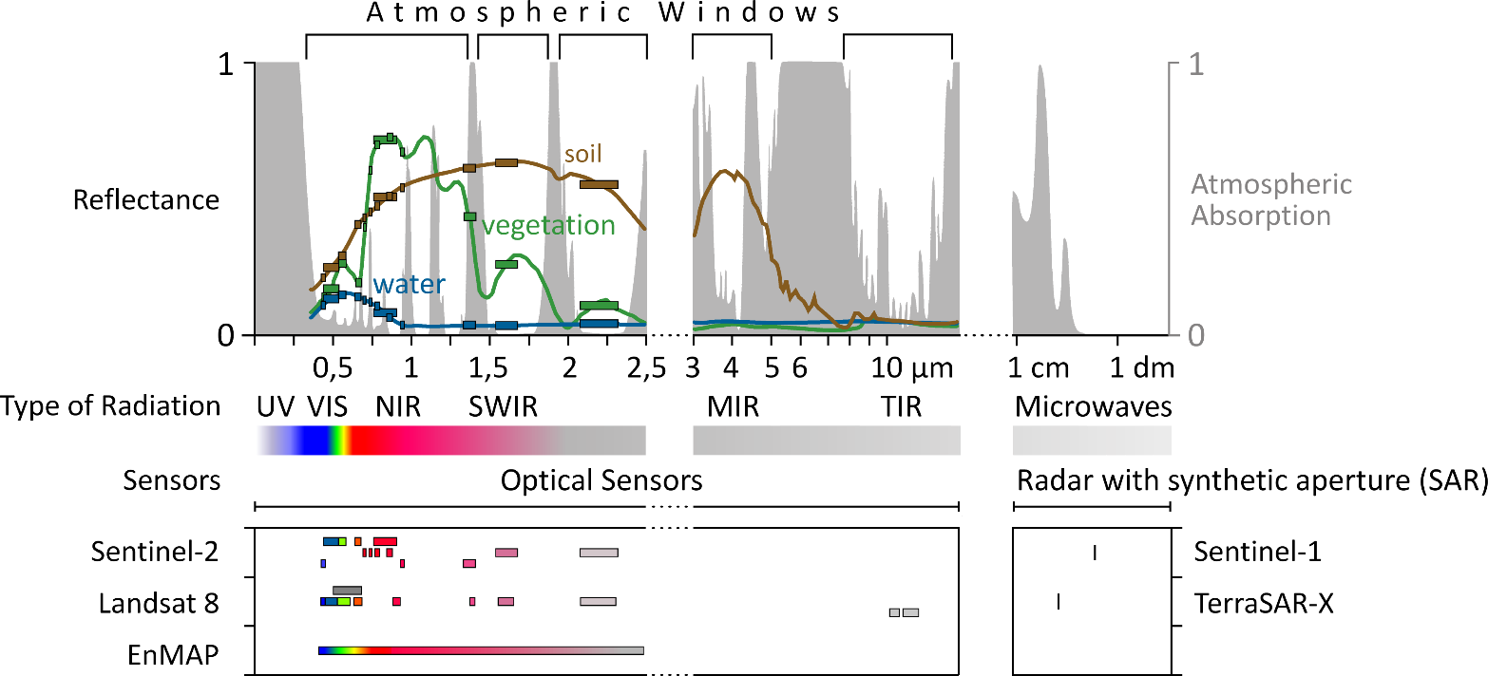
Atmospheric transmission and regions of operation for remote sensors
PRISMA
Notes:
More than three decades of effort have been devoted to the development of imagers capable of acquiring contiguous spectra in different wavelength regions, thereby permitting precise and quantitative analysis of terrestrial and aquatic ecosystems. These imaging spectrometers have primarily been flown in aircrafts for experimental and commercial purposes, e.g., casi, AVIRIS, GER/DAIS, HyMap, APEX, AVIS, AISA, and HySpex. However, data acquisition from an aircraft platform cannot provide a synoptic view of extended areas and repeated acquisitions are costly. For a more complete overview of airborne imaging spectroscopy sensors and their history refer to Schaepman (2009).
In general, operational optical satellite sensors have been multispectral instruments, operating in selected discrete bands in the VNIR region including in some cases bands in the SWIR and thermal infrared (TIR) region of the spectrum (e.g., Landsat, ASTER). The panchromatic sensors provide only spatial information, while the multispectral instruments, such as the broadband systems Landsat, SPOT, ASTER, or Sentinel 2 augment the spatial data with mainly qualitative information about the surface materials. Exceptions are the few launched hyperspectral sensors NASA’s Hyperion (from 2000 to 2016), NASA’s HICO (from 2009 to 2015), and ESA’s CHRIS (since2001). Considering that Hyperion and CHRIS were designed for a 1-year lifetime, they have provided exceptional results. Nonetheless, CHRIS and HICO are limited to the VNIR region, while Hyperion is characterized by a low signal-to-noise ratio. Both of these factors limit the sensors in their feature detection capabilities. Therefore, current spaceborne sensors provide only limited information on biochemical and geochemical parameters, which are required for detailed environmental studies.
In view of these developments, the EnMAP mission represents a milestone towards a comprehensive hyperspectral observation from space.

Slide 14
Data product
Notes:
“No property of images is more widely quoted, and simultaneously misused, than resolution. It is a term that conveys a strong intuitive meaning, but is difficult to define quantitatively. Remote sensing systems have “resolution” in the spectral, spatial, and temporal measurement domains. Furthermore, there is a numerical resolution associated with the data itself by virtue of radiometric quantization.” Schowengerdt (2007)

Slide 15
Spectral resolution (I)

Slide 16
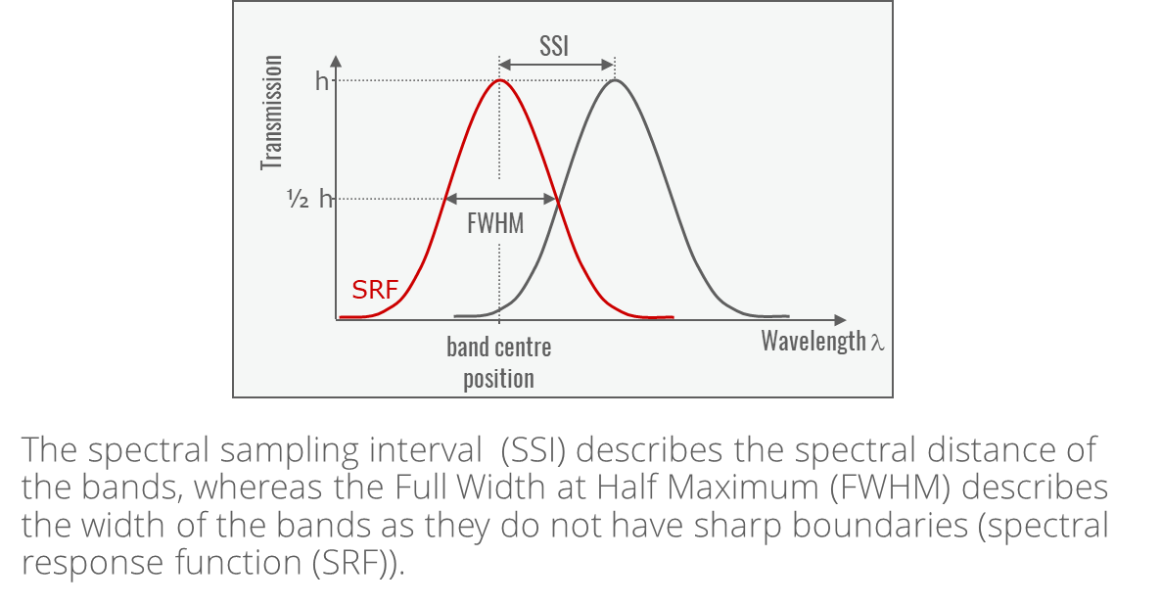
Spectral resolution (II)
Notes:
Contiguous spectral coverage between 400 and 2500 nm with a spectral sampling interval at FWHM of less or equal 10 nm is aspired to by land observing sensors, driven by the need for atmospheric characterization and reflectance retrieval, as well as some geophysical, geo-biophysical, and geochemical retrievals for environmental measurements and agricultural applications. For ocean-observing sensors focusing on ‘Ocean Colour’ variables often, a spectral sampling around 5 nm is required. For radiative forcing by impurities in snow, 20 nm is the generally accepted requirement. Ultimately, a sensor with a semi-static spectral resolution that can accommodate the science requirements is more cost-effective than varying the spectral resolution across the spectrum.” Rast and Painter (2019)

Slide 17
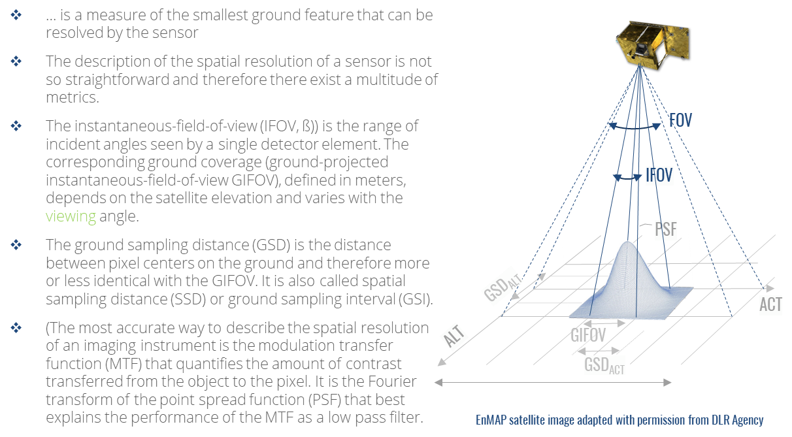
Spatial resolution (I)
Notes:
“While airborne imaging spectrometers typically have a spatial sampling of ≤ 1 m (depending on the flight altitude), spaceborne land observation imaging spectrometers have a spatial resolution in the range of tens of meters, i.e. 20–60 m to resolve the scales of spatial variability of the observed constituent. For Ocean Colour imaging spectrometers, the spatial sampling requirements range typically between 100 and 300 m.” Rast and Painter (2019)
GSD refers to “ground sample distance” or "ground sampling distance“, both terms are common.

Slide 18
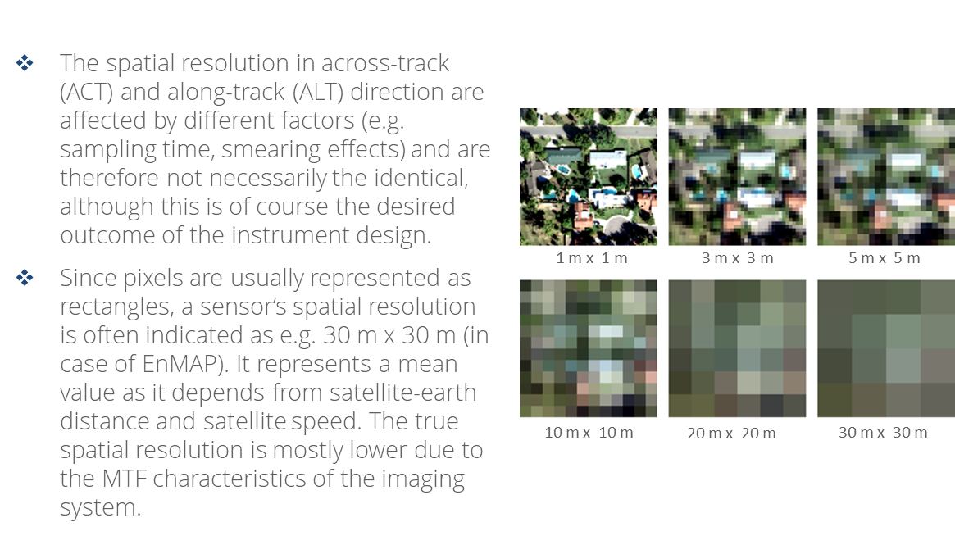
Spatial resolution (II)

Slide 19
Temporal resolution
Notes:
“The cadence of clear-sky acquisitions varies according to the science or application question. For snow and ice, an average of one clear acquisition per week is required, whereas for ocean observation a cadence of the order of about 3 days is required. For agricultural applications, repeat observations every 5–10 days are needed, for biodiversity and biogeochemical measures seasonal clear acquisitions will suffice but generally require a broader spatial coverage.” Rast and Painter (2019)

Slide 20
Radiometric resolution

Slide 21
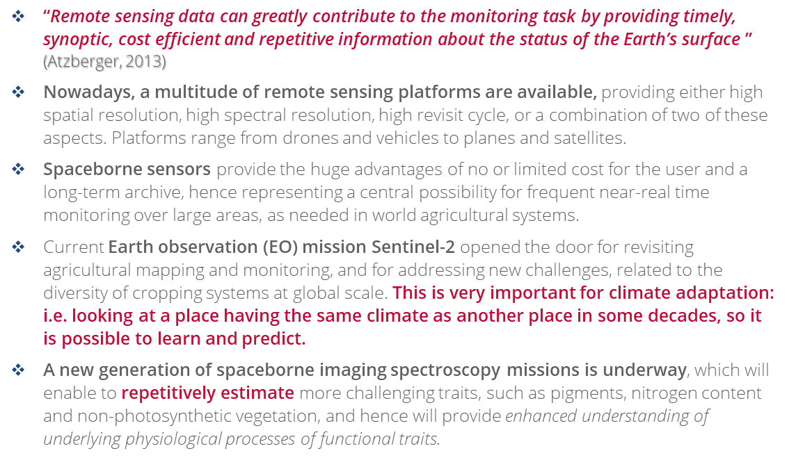
Spaceborne hyperspectral sensing for agricultural monitoring

Slide 22
Spaceborne hyperspectral sensing for agricultural monitoring

Slide 23
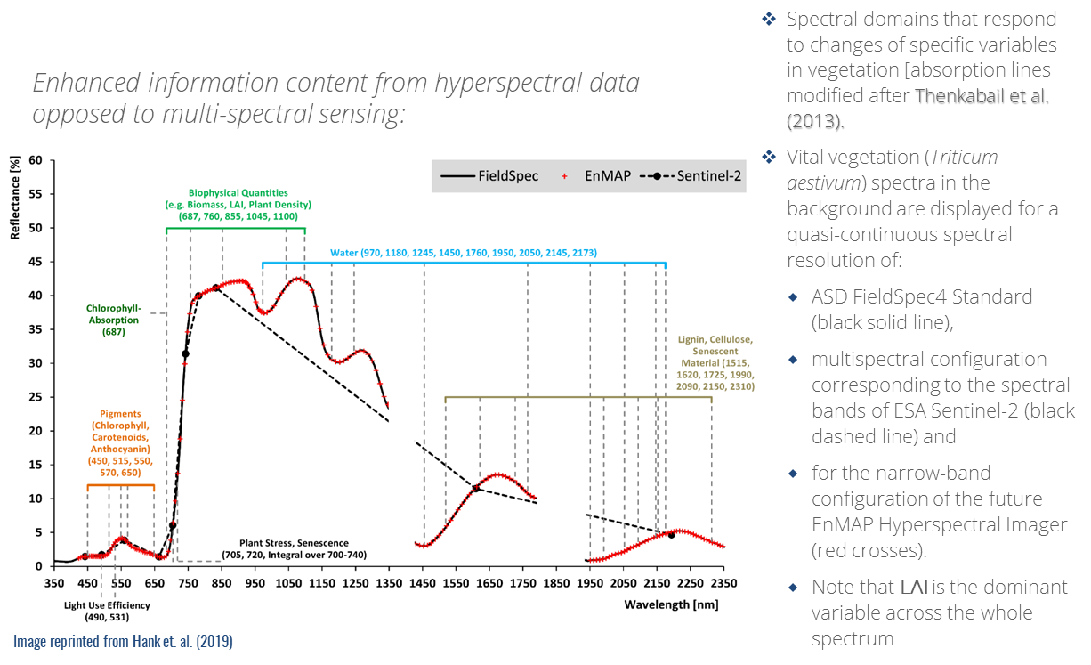
Satellite imaging spectroscopy
Notes:
Hank et al., 2019: “Spectral domains that respond to changes of specific variables in vegetation [absorption lines modified
after Thenkabail et al. (2013)]. The vital vegetation (Triticum aestivum) spectra in the background are
displayed for a quasi-continuous spectral resolution of an ASD FieldSpec4 Standard (black solid line), for a
multispectral configuration corresponding to the spectral bands of ESA Sentinel-2 (black dashed line) and
for the narrow-band configuration of the future EnMAP Hyperspectral Imager (red crosses). In the case of
vital vegetation, specific absorptions of, e.g., cellulose and lignin are obscured by water absorptions in the
SWIR and only can be detected when the crop is senescing”

Slide 24
Data properties

Slide 25
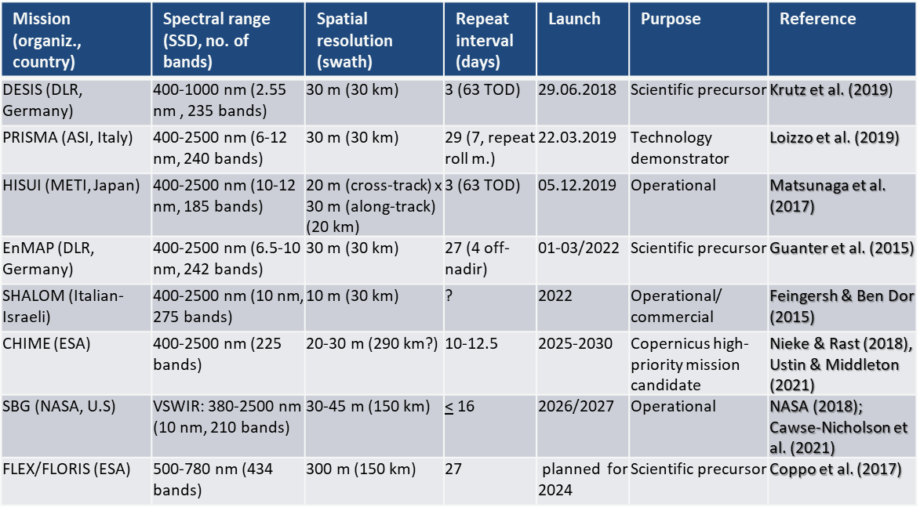
Next-generation spaceborne hyperspectral sensors

Slide 26
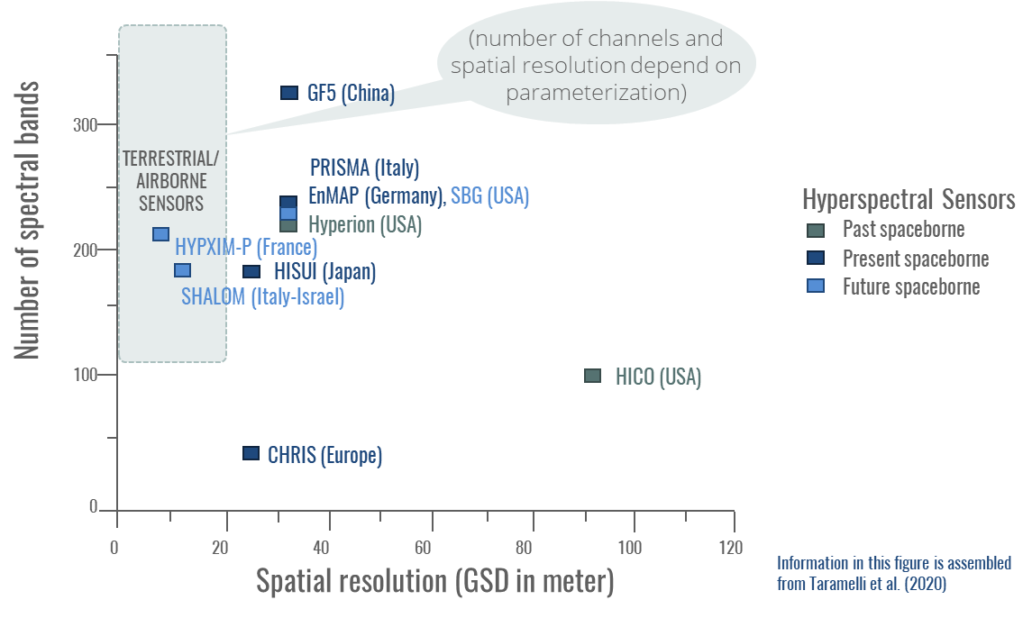
Resolutions of selected hyperspectral sensors
Notes:
More than three decades of effort have been devoted to the development of imagers capable of acquiring contiguous spectra in different wavelength regions, thereby permitting precise and quantitative analysis of terrestrial and aquatic ecosystems. These imaging spectrometers have primarily been flown in aircrafts for experimental and commercial purposes, e.g., casi, AVIRIS, GER/DAIS, HyMap, APEX, AVIS, AISA, and HySpex. However, data acquisition from an aircraft platform cannot provide a synoptic view of extended areas and repeated acquisitions are costly. For a more complete overview of airborne imaging spectroscopy sensors and their history refer to Schaepman (2009).
In general, operational optical satellite sensors have been multispectral instruments, operating in selected discrete bands in the VNIR region including in some cases bands in the SWIR and thermal infrared (TIR) region of the spectrum (e.g., Landsat, ASTER). The panchromatic sensors provide only spatial information, while the multispectral instruments, such as the broadband systems Landsat, SPOT, ASTER, or Sentinel 2 augment the spatial data with mainly qualitative information about the surface materials. Exceptions are the few launched hyperspectral sensors NASA’s Hyperion (from 2000 to 2016), NASA’s HICO (from 2009 to 2015), and ESA’s CHRIS (since 2001). Considering that Hyperion and CHRIS were designed for a 1-year lifetime, they have provided exceptional results. Nonetheless, CHRIS and HICO are limited to the VNIR region, while Hyperion is characterized by a low signal-to-noise ratio. Both of these factors limit the sensors in their feature detection capabilities. Therefore, current spaceborne sensors provide only limited information on biochemical and geochemical parameters, which are required for detailed environmental studies.
In view of these developments, the PRISMA and EnMAP missions represent a milestone towards a comprehensive hyperspectral observation from space.
(Based on Rast and Painter 2019)

Slide 27
EnMAP – Main mission characteristics

Slide 28
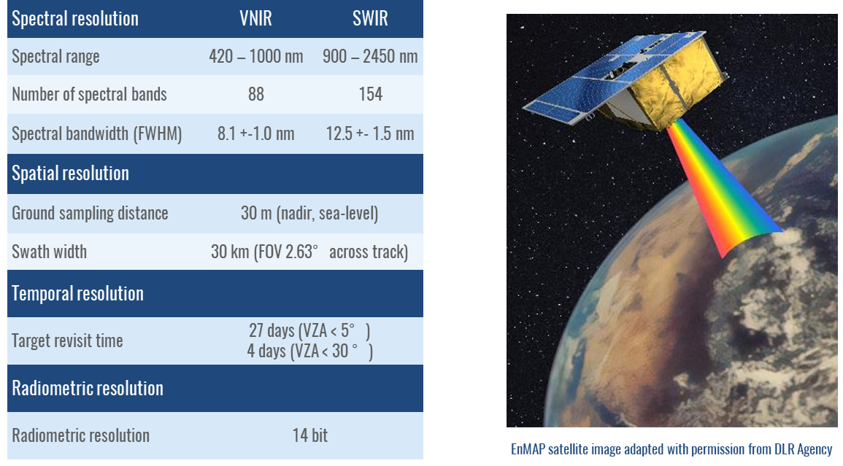
EnMAP – Main mission characteristics
Notes:
EnMAP is of key importance to monitor environmental degradation and change and will contribute to improved concepts for sustainable management of land and other natural resources. The missions main goals are:
to provide high-quality calibrated data on a timely and frequent basis for retrieval of ecosystem variables to be used as inputs for improved modeling and understanding of biospheric /geospheric processes
to provide unique data needed to address major environmental problems related to human activities and climate change
to provide high-quality hyperspectral imagery on a frequent basis to contribute to the understanding of coupled processes and complex feedback mechanisms across the spheres of the Earth

Slide 29
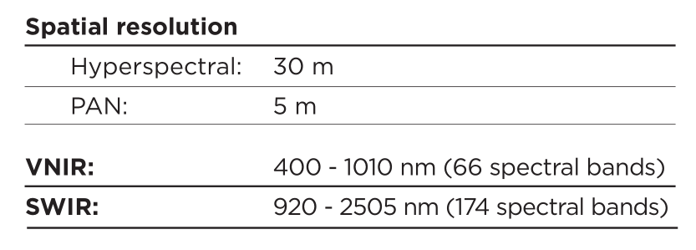
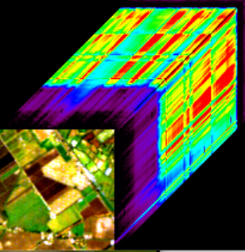
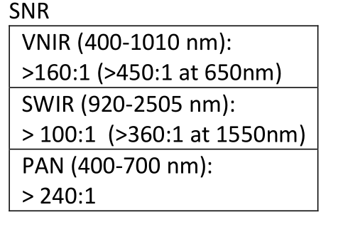
PRISMA – Main mission characteristics
On the 22 March 2019 the Italian Space Agency (ASI) launched the hyperspectral PRISMA scientific mission, having onboard an imager covering the 400-2500 nm range with 234 spectral bands and about 10 nm of bandwidth.
ASI L2d product:
Geolocated & geocoded at surface reflectance
(Hyperspectral / PAN).
It includes:
- Aerosol Characterization Product (VNIR);
- Water Vapour Map - Cloud Characterization
Spectral Accuracy: ±0.1 nm
Absolute Radiometric Accuracy: 5%
with 12 bits quantized data

Slide 30
Promising ESA next-generation sensors

Slide 31
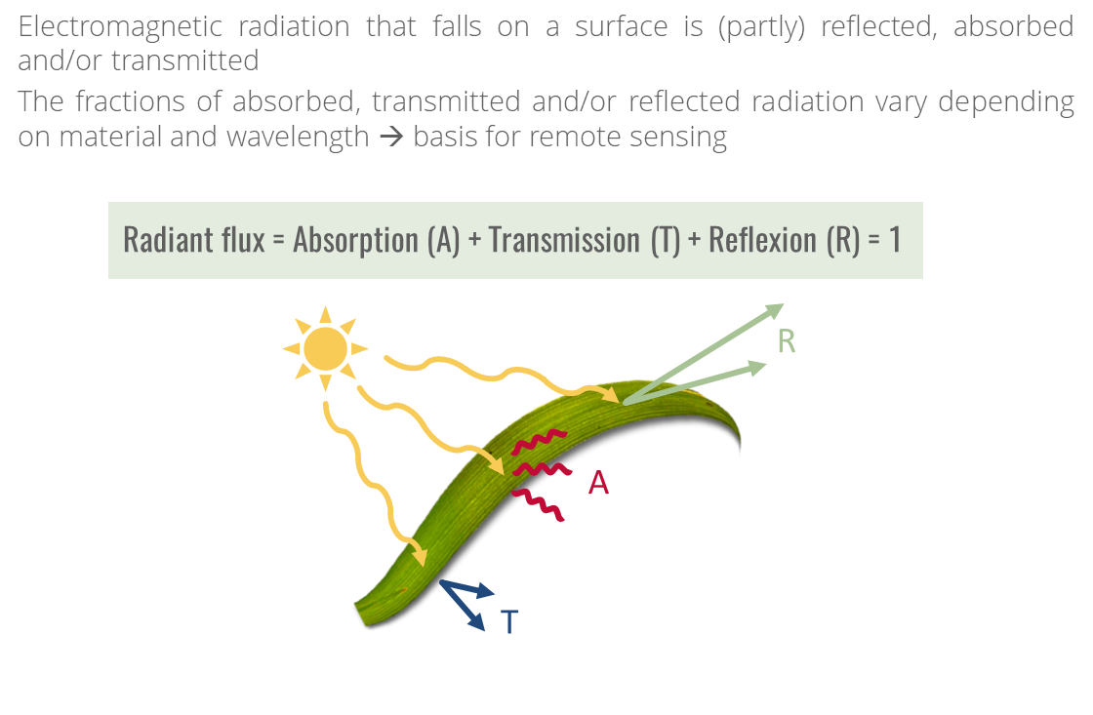
Interaction radiation – target
Notes:
On the Earth's surface, the radiation finally interacts with an object and is partly absorbed, reflected, and (in case of non-opaque objects) transmitted. Absorption is the uptake of energy by a substance. Reflection means that incoming radiation is reflected without energy being absorbed or emitted. During transmission, the radiation penetrates an object without energy change. The reflected part of the radiation leaves the object as directed spectral radiation, modified by the spectral characteristics (degree of reflection) of the object. The distribution depends on the wavelength of the radiation as well as the material and state of the surface. The reflectance differences between individual surfaces allow us to distinguish them on satellite images.

Slide 32
Interaction radiation – target (II)
Notes:
The most important process for optical remote sensing is absorption. Radiant energy arriving at an object stimulates electron transfer (to higher energy levels) and vibrational processes (stretching, rotational and deformation oscillations) at the molecular level. Detailed descriptions of these processes can be found e.g. in Hunt (1977) and Clark (1999).
In short, energy is extracted from the incoming radiation, and released when the process relaxes. This energy is used for processes of material conversion (e.g. photosynthesis) and leads to the heating of the object, which results in the emission of long-wave radiation. Since only discrete electron levels can occur in atoms and the excitation of oscillation processes is only possible by photons with a certain energy, a certain wavelength can be assigned to each absorption process.
Electron transfer processes require a lot of energy. The bands caused by them are therefore usually quite broad and in the short-wave UV range, partly with absorption minima extending into the visual range (e.g. iron oxides). Vibrational processes cause rather narrow bands in the SWIR range because their excitation requires less energy.

Slide 33
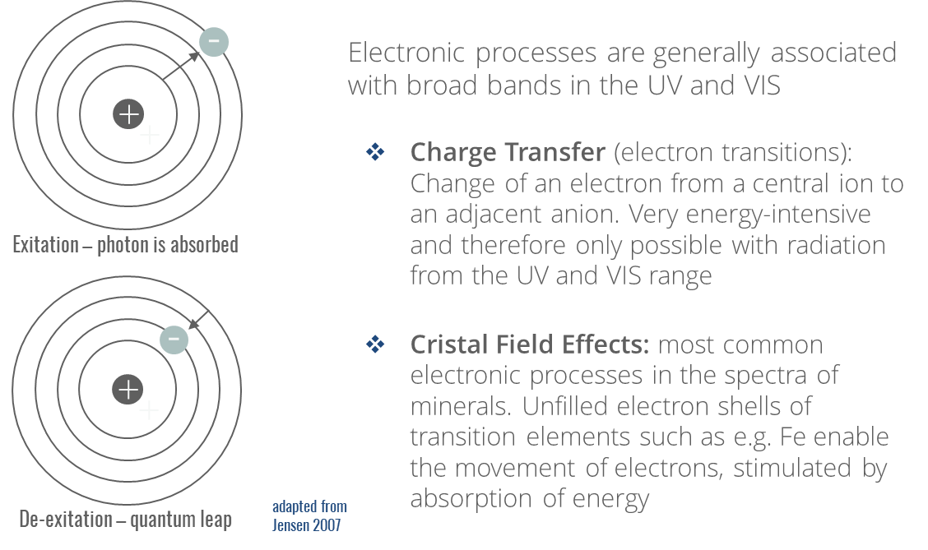
Spectral absorptions (I) electronic processes
Notes:
When radiation interacts with a surface, the characteristics of electromagnetic radiation change. This change is caused by the transition of electrons between energy states. Since atoms or molecules can only possess certain discrete energy states, the energy of an emitted or absorbed photon equals the difference between these discrete energy levels. Absorption due to electronic transition is wavelength specific and usually produces broad bands in the ultraviolet (UV) range that extend to the VIS.
The absorptions referred to as crystal field effects are the most common electronic processes revealed in the spectra of minerals. They are caused by unfilled electron shells of transition elements such as Ni, Cr, Co, Fe, etc., enabling the movement of electrons stimulated by absorption of energy. Thereby, the resulting absorption features mainly depend on the valence state (e.g. Fe2+, Fe3+) of the ion as well as the crystal structure.
Charge transfer bands produce features due to inter-element electron transitions, where the absorbed energy causes electrons to migrate between ions or between ions and ligands. The charge transfer may also occur between adjacent ions of the same metal in different valence states. Since such transfer requires high levels of energy, the absorption features are usually up to thousand times more intense than those produced by crystal field effects. Thus, they appear mostly in the UV and VIS wavelength region. Conduction bands occur only in metallic bonds which are characterized by very close levels of energy between which the electrons change.
(based on Clark, 1999 and Hunt, 1977)

Slide 34
Spectral absorptions (II) vibrational processes
Notes:
Features produced by vibrational processes result from the vibration of ions or molecules in a crystal lattice. Thereby, the frequency of vibration depends on the number and mass of a molecule’s atoms, and the strength of the ion bonds. A molecule composed of n ions has 3n-6 normal modes of vibration. These are called fundamentals. The fundamental bands of most materials occur at wavelengths greater than 2.5 μm, which is out of the spectral range Observed by most imaging spectrometers such as EnMAP. This restricts the detection of features produced by vibrational processes to overtone bands (roughly multiples of single fundamental modes), and combination bands (combinations of different vibrational modes) of molecules with very high fundamental frequencies. Features usually get weaker with each higher overtone or combination. In contrast to the generally broad UV and VIS bands associated with electronic transitions, vibrational processes produce sharp features that are stronger in the SWIR and decrease in intensity and frequency of occurrence towards the NIR. Molecules providing high frequency fundamentals and hence producing particularly diagnostic vibrational absorption bands in in the SWIR are H₂O and OH⁻ and CO₃²⁻.
(based on Clark, 1999 and Hunt, 1977)

Slide 35
H₂O - three fundamental modes of vibration
Notes:
In order to understand how vibrational processes happen, it is helpful to visualize atoms and bonds → if you picture atoms as “balls” the vibrations of atoms can be explained as “springs”.
“Molecular vibrations in the NIR regions consist of stretching and bending combination and overtone bands. Stretching vibrations occur at lower wavelengths than bending vibrations. Stretching vibrations are either symmetric or asymmetric; bending vibrations are either in-plane or out-of-plane. In-plane bending consists of scissoring and rocking; out-of-plane bending consists of wagging and twisting. From the highest frequency to lowest, the vibrational model occur as stretching, in-plane bending (scissoring), out-of-plane bending (wagging), twisting, and rocking. The most-often observed bands in the NIR include the combination bands and first, second, or third overtones of O-H, N-H, and C-H fundamentals.” Workman & Weyer 2007
Recommendation for animated graphics (August 2019): https://chem.libretexts.org/Bookshelves/Physical_and_Theoretical_Chemistry_Textbook_Maps/Supplemental_Modules_(Physical_and_Theoretical_Chemistry)/Spectroscopy/Vibrational_Spectroscopy/Infrared_Spectroscopy/Infrared%3A_Theory

Slide 36
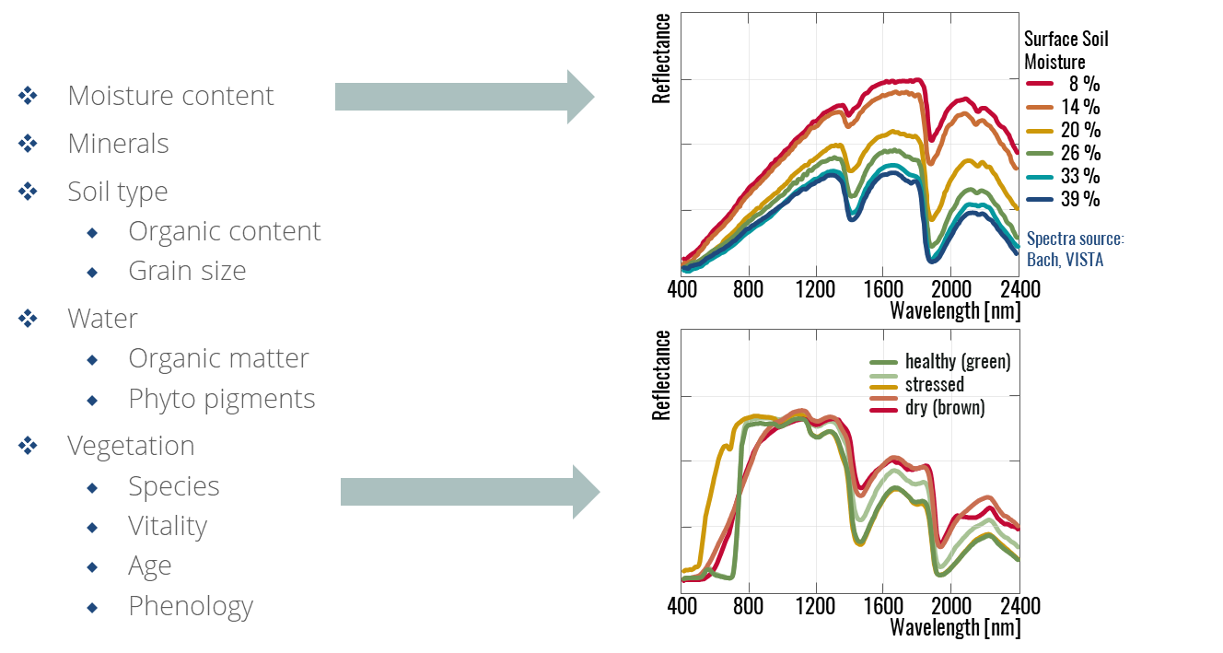
Influencing factors: physics

Slide 37
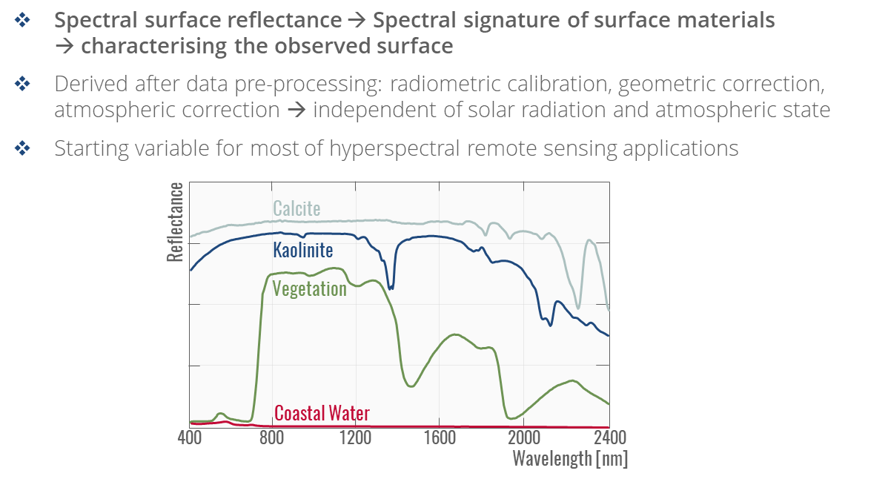
Spectral surface reflectance
Notes:
As learned from the previous slides, imaging spectroscopy is based on the measurement of electromagnetic radiation reflected from different objects. These objects have different surface properties and therefore absorb, reflect or transmit electromagnetic radiation in different ways. Apart from the geometric conditions (e.g. angle of incidence of sunlight and sensor position) and the roughness of its surface, the reflection properties of an object depend on its material and its physical and chemical properties (e.g. moisture content). Because of these differences, many materials of the Earth's surface can be identified by analyzing their spectral reflectance signatures. These signatures can be represented in so-called spectral reflectance curves as a function of wavelength. The figure on this slide shows typical spectral reflectance curves of green vegetation, coastal water as well as the minerals Kaolinite and Calcite.

Slide 38
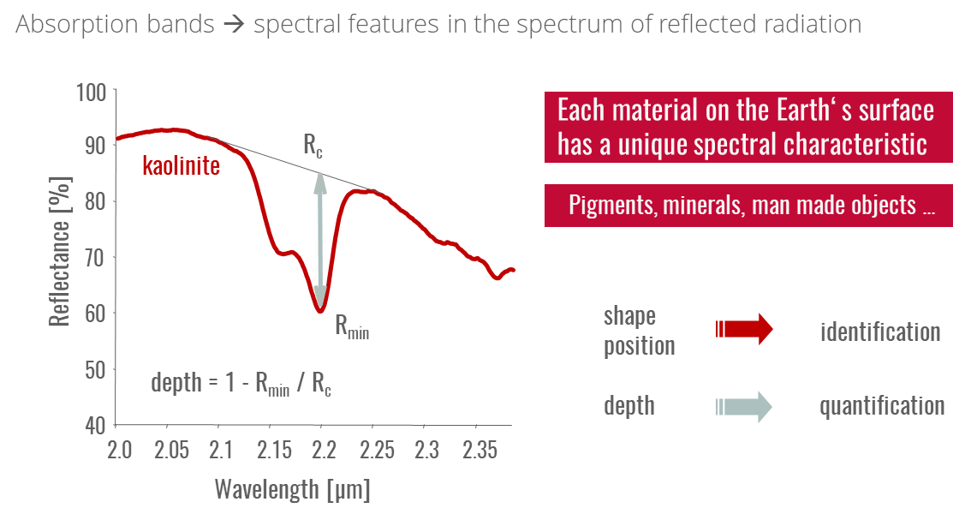
From absorption bands to material identification and quantification
Notes:
Each material on the Earth‘s surface has a unique spectral characteristic. As explained previously, electronic and vibrational processes result in so called „absorption features“, spectral absorption minima and maxima. The shape and position (wavelength) of these features allows the identification of materials, their depth (to some extent) the quantification.

Slide 39
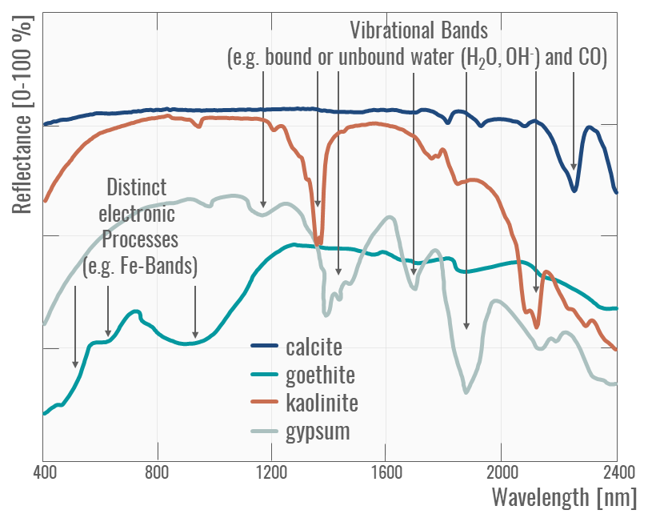
Reflectance of distinct minerals
Notes:
Reflectance spectra of minerals are dominated in the visible near-infrared (VNIR) wavelength range (400 nm to 1400 nm) by the presence or absence of transition metal ions (e.g., Fe, Cr, Co, Ni) resulting in absorption features due to electronic processes. The presence or absence of water and hydroxyl, carbonate and sulphate determine absorption features in the SWIR region due to vibrational processes. These phyllosilicates, sorosilicates, hydroxides, sulphates, amphiboles and carbonates are widespread components of the Earth’s surface. The absorption band depth is related to grain or particle size, as the amount of light scattered and absorbed by a grain is dependent on grain size (van der Meer et al., 2012). In general, absorption band depth is correlated with the (relative) amount of material present.

Slide 40
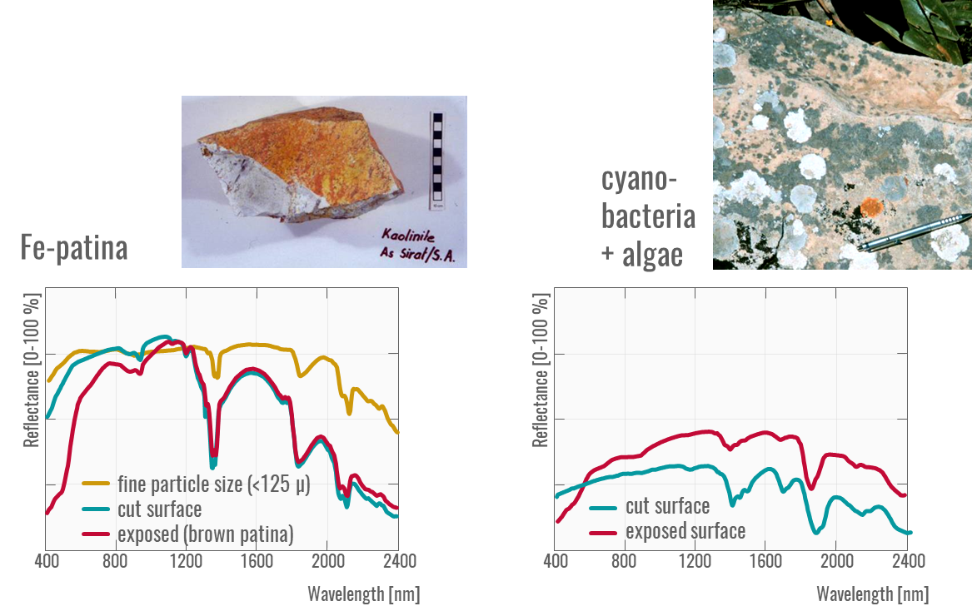
Reflectance of surface coatings
Notes:
These figures present surface reflectance spectra where surface coatings (e.g. an iron oxide patina on Kaolonite and lichens) alter the surface and thus conceal characteristic reflectance features

Slide 41
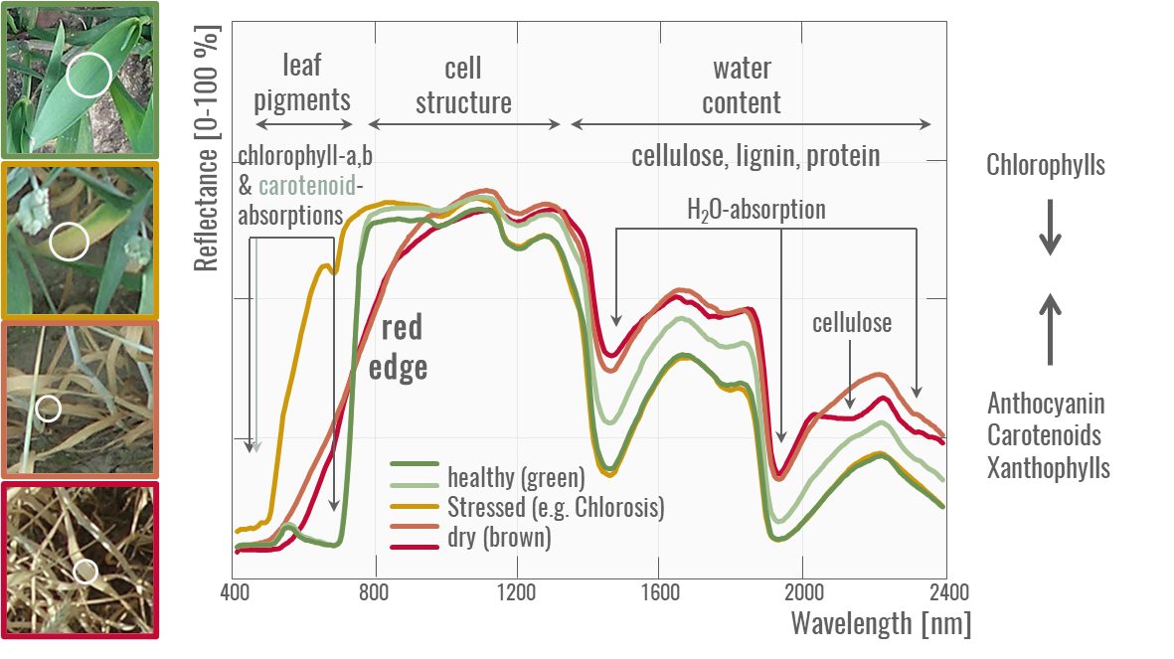
Reflectance of vegetation (I)
Notes:
Absorption characteristics of vegetation are predominantly very similar, even between plant species, because the molecular mechanisms underlying the absorption are found in various substances of the plants (e.g. O-H bond in water, cellulose and starch). Therefore, clear assignments of absorption bands and molecular processes are difficult to make. Except for the leaf pigments (e.g. chlorophyll and carotenoids), many of the biochemical plant substances occur only in low concentrations, so that only minimal absorption bands are measured. In addition, there are multiple scattering processes at leaf (mesophyll), plant, as well as at canopy level, which determine the shape of the absorption bands.
In general, the spectral reflectance curve of healthy green vegetation has a minimum in the visible (VIS) part of the electromagnetic spectrum due to leaf pigments. Chlorophyll pigments selectively absorb blue (400–500 nm) and red (600–700 nm) light for photosynthesis and less green light (500–600 nm), resulting in a “green peak” and the green appearance of healthy vegetation to human eyes. Other pigments like carotenoids and xanthophylls have strong absorptions in the blue wavelengths range (400–500 nm) and are responsible for various leaf colors.
The spectral reflectance curve increases strongly towards the near-infrared range (NIR). In the NIR (700-1300 nm), leaf absorption by pigments and other constituents is small and most energy is transmitted or reflected, depending on leaf structural characteristics, resulting in a high plateau.
The range between red (VIS) light and near infrared is characterized by a steep slope, called "red edge“ and is used in plant stress detection. The reflectance of stressed vegetation is generally higher in the VIS and lower in the infrared range as compared to healthy vegetation. Besides, there is a flattening and shift to shorter wavelength in the red edge portion of the spectrum.
The SWIR region (1300–2500 nm) is dominated by water absorption (particularly at 1400 and 1900 nm) with reflectance increasing with decreasing leaf water content.
(based on Huete 2004 and Ustin 2004)

Slide 42
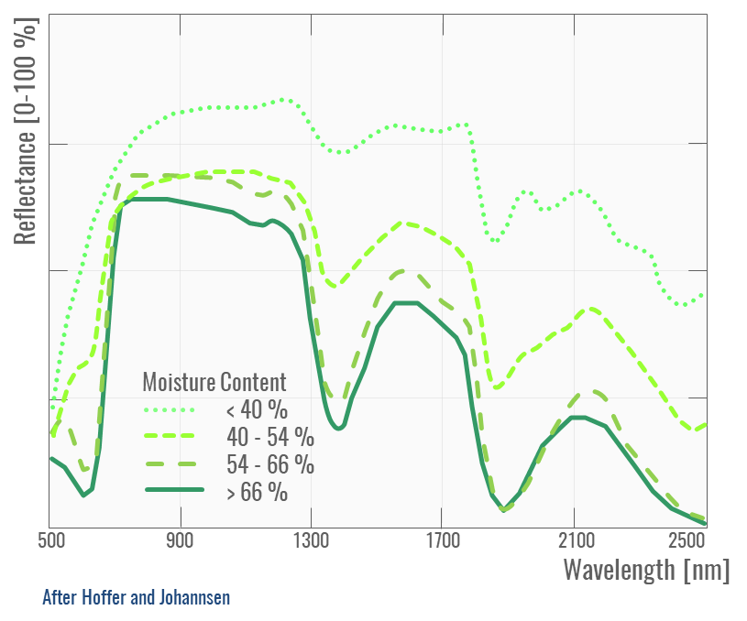
Reflectance of vegetation (II)
Notes:
An increase in leaf moisture content results in a general decreae of reflectance, especially in the NIR and SWIR, accompanied by an increase (depth, width) of the water absorption features near 1400 and 1900 nm.

Slide 43
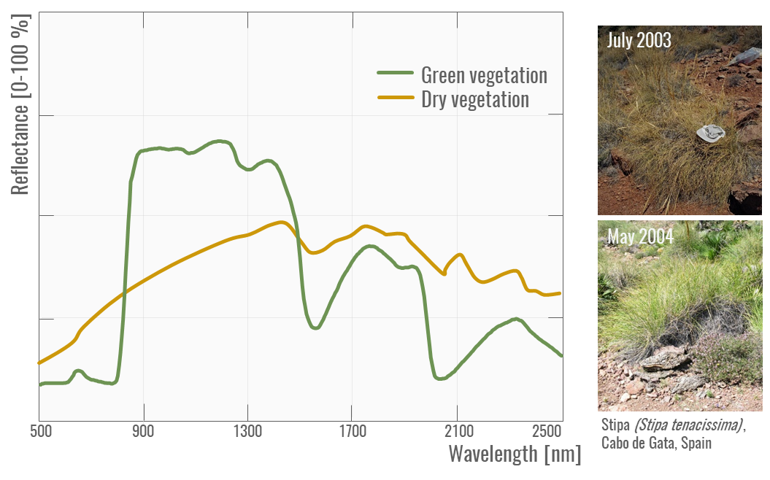
Reflectance of vegetation (III)
Notes:
Dry or “nonphotosynthetic” vegetation (NPV) has unique spectral signatures, depending on their stage of decomposition: As chlorophyll pigments degrade, the red reflectance (600–700 nm) increases, resulting in a yellowing appearance of vegetation to our human eyes. Later, the more persistent carotenes degrade as well, causing an increase in blue reflectance (400–500 nm) and a greyish appearance of vegetation as in the dry Stipa grass. Simultaneously, the SWIR signal increases and lignin absorption features become visible. Eventually, vegetation litter will fully decompose and become (organic) part of the soil (Huete 2004)

Slide 44
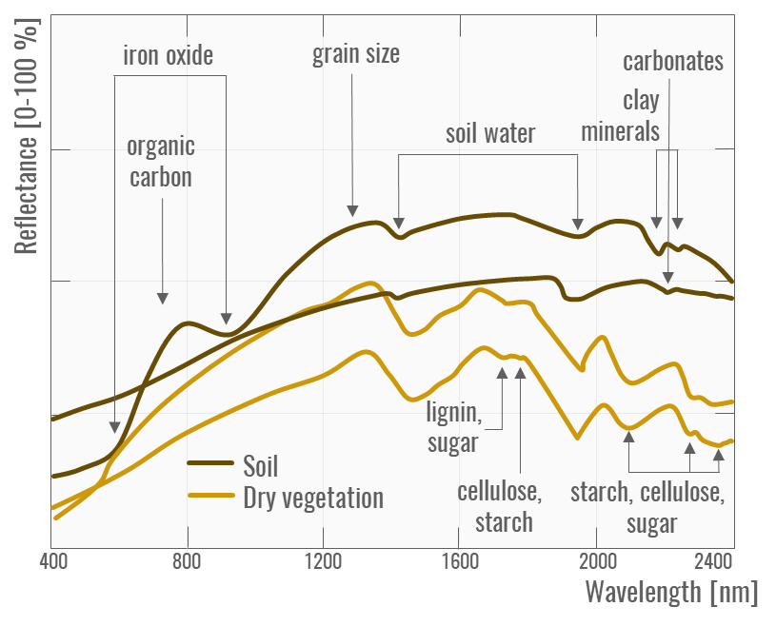
Reflectance of soil
Notes:
Since the major constituents of soil minerals do not exhibit absorption features in the VNIR and SWIR range (Hunt, 1977), their spectral reflectance characteristics are mainly influenced by organic matter content, clay mineral composition, iron-oxide content, moisture content, salinity, texture and surface roughness. Typically, soils have broad, shallow absorption features at wavelengths between 400 nm and 2500 nm that are related to iron oxide and organic matter. In general, reflectance decreases with increasing organic matter and/or moisture content. Increases in particle size also cause a decrease in overall reflectance. Even small amounts of iron oxides can alter VNIR spectra significantly, causing broad absorption features particularly around 400 nm, 700 nm and 870 nm (Ben-Dor et al. 1999). In contrast, several clay minerals (e.g., montmorillonite, kaolinite, illite, smectite) and carbonates display distinctive narrow-band absorption features in the SWIR range between 2000 nm and 2500 nm (Ustin et al., 2004).
By the way, in order to differentiate between bare soil and dry vegetation, hyperspectral information is crucial.

Slide 45
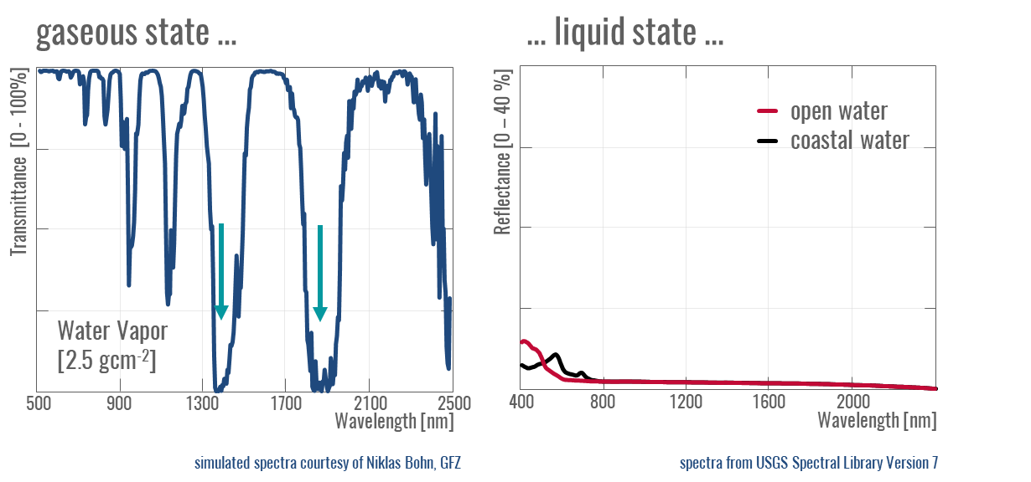
Reflectance of water (I)
Notes:
The reflectance curve of liquid water is characterized by low reflectance in the visible range and high (almost complete) absorption in the near infrared and beyond. Due to these absorption properties, water bodies and objects containing water can be easily delineated and identified by remote sensing. Turbid water such as water rich in chlorophyll reflects more strongly in the VIS than clear water. These patterns are used to document algae blooms or contamination, e.g. by oil or industrial wastewater.
EnMAP science plan:
Imaging spectroscopy has been widely used to monitor oceans and inland waters, which are characterized by an overall high absorption of radiant energy compared to land surfaces (Figure 2). This characteristic makes water suitable to isolate and measure its optical constituents, such as pigments (e.g., chlorophyll), a wide range of phytoplanktonic species, dissolved organic matters, and suspended non-algal particles (e.g., minerogenic sediments). Coastal and inland waters are optically more complex as compared to open oceanic waters, which can be characterized mainly by one optical parameter and are generally referred to as case-1 waters (Morel and Prieur, 1977). In contrast, inland and coastal waters are influenced by multiple parameters.

Slide 46
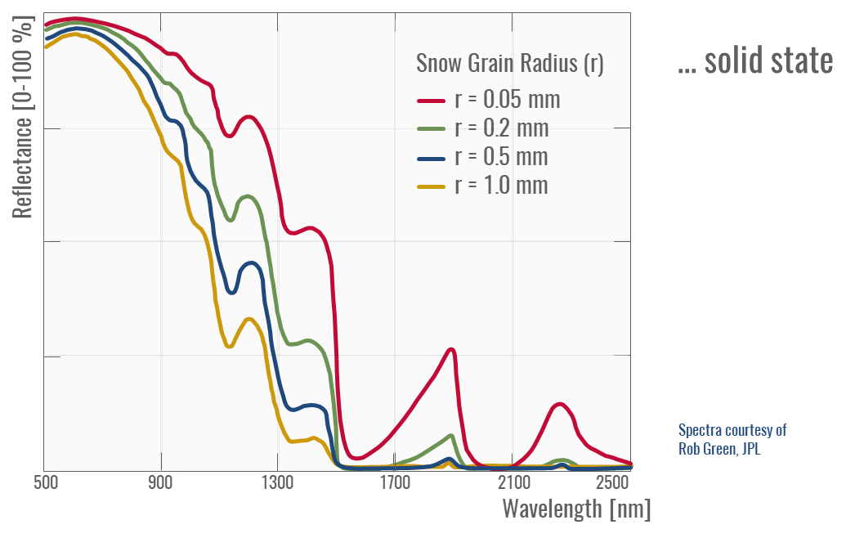
Reflectance of water (II)
Notes:
Snow cover and its subsequent melt can dominate local to regional climate and hydrology in the world’s mountainous and Polar Regions. To model the snowmelt distribution and its impact, hyperspectral remote sensing allows for the retrieval of snow properties, such as snow-covered area, albedo, grain size, very near surface liquid water, and impurities (Dozier and Painter, 2004). Among natural materials at the Earth’s surface, snow has a huge range of spectral reflectance values depending on its physical characteristics, primarily the grain size but also dust or soot content, organic substances such as algae, and liquid water (Dozier et al., 2009). Clean, deep snow is highly reflective in the VIS spectrum, whereas reflectance in the NIR and SWIR wavelengths shows a general decrease, but varies considerable depending primarily on the grain size

Slide 47
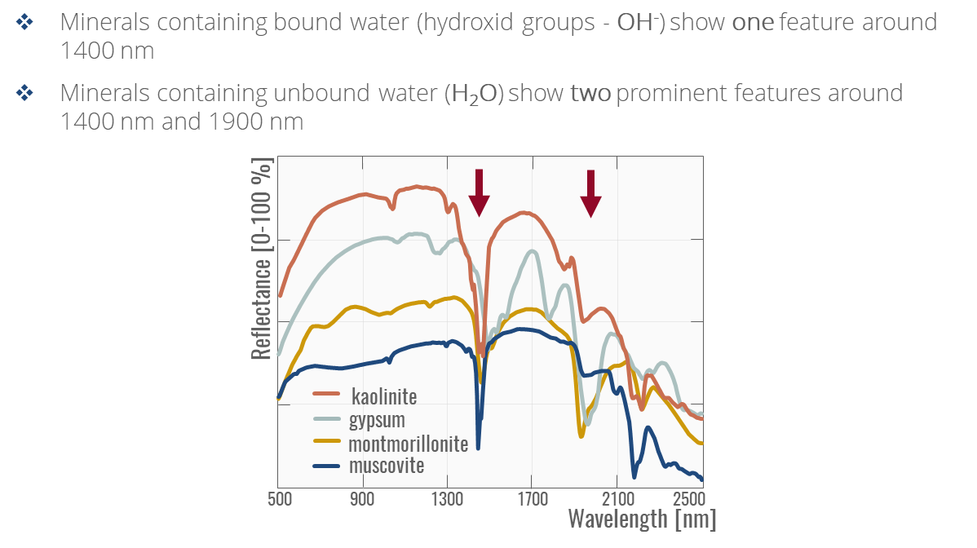
Reflectance of water (III)

Slide 48
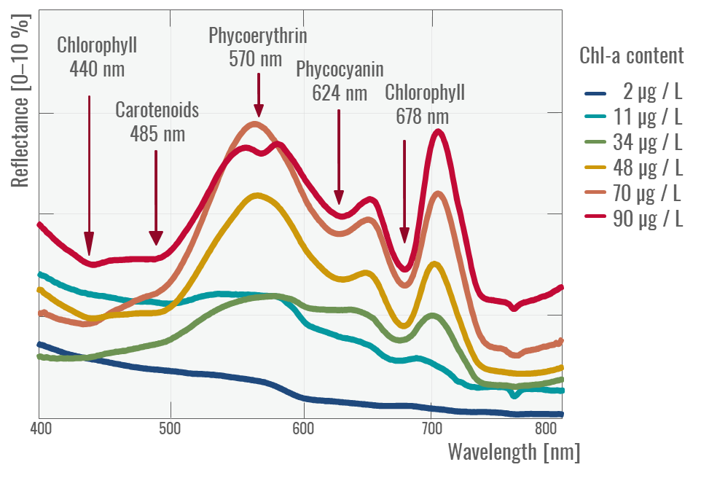
Reflectance of phytopigments
Notes:
Turbid water such as water rich in chlorophyll reflects more strongly in the VIS than clear water, which is used to document e.g. algae blooms. Thereby, different phytopigments have their own absorption characteristics that allow quantification of chlorophyll and to some extent differentiation of algae type.

Slide 49
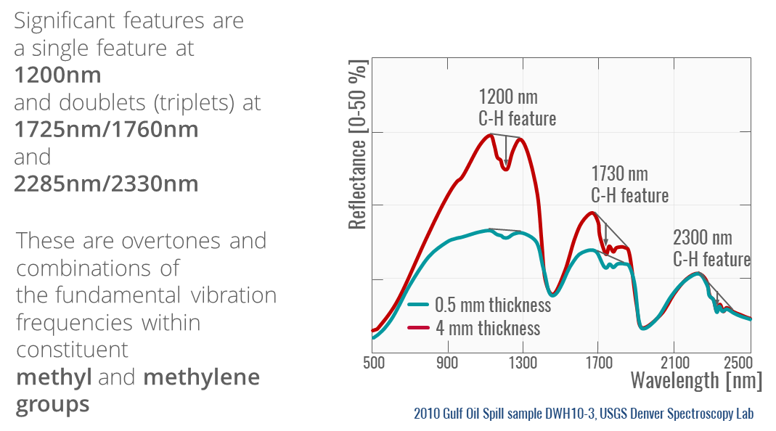
Reflectance of hydrocarbons

Slide 50
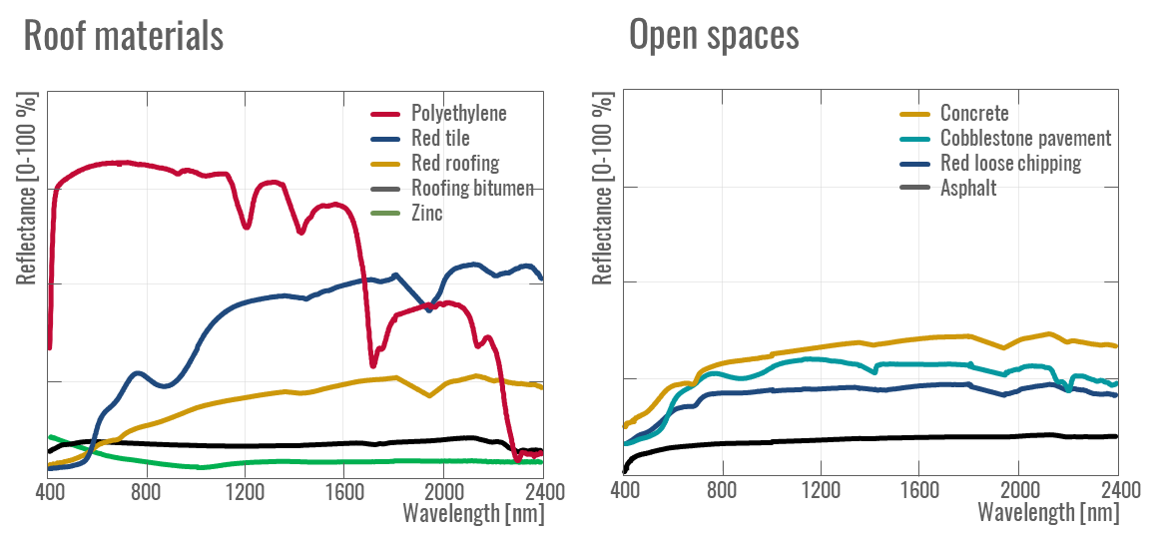
Reflectance of man-made surfaces
Notes:
Urban areas are characterized by a wide range of spectrally distinct surface materials, whose spectral signature is determined by its chemical composition. For example, roofing tiles and polyethylene exhibit pronounced absorption features and high-spectral variation, whereas other urban surfaces, such as concrete and asphalt, are characterized by low reflectance and low spectral variation.

Slide 51
Leaf chlorophyll content (LCC)

Slide 52
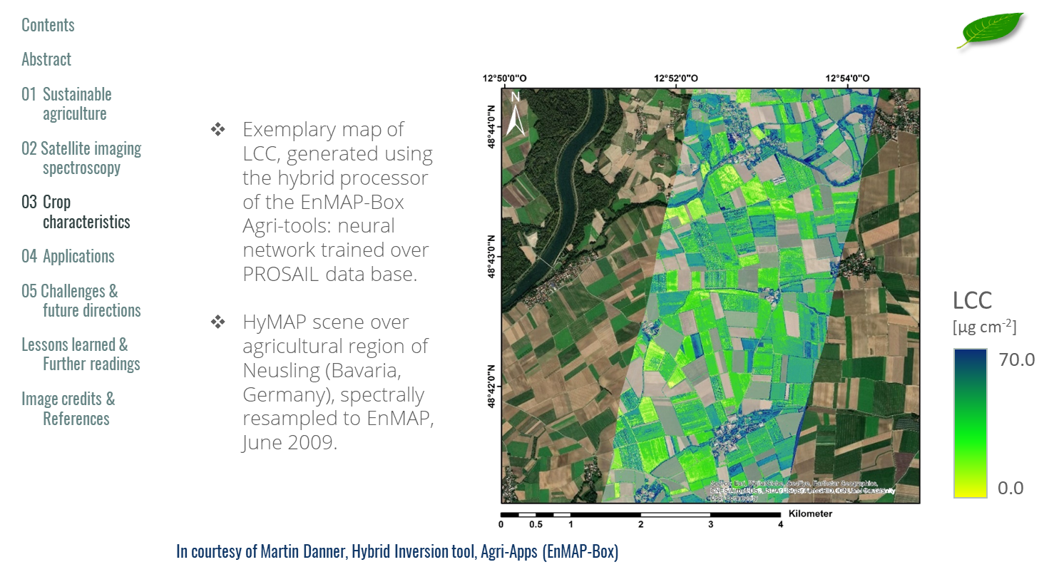
LCC mapping example

Slide 53
Leaf carotenoid content (C_{xc})

Slide 54
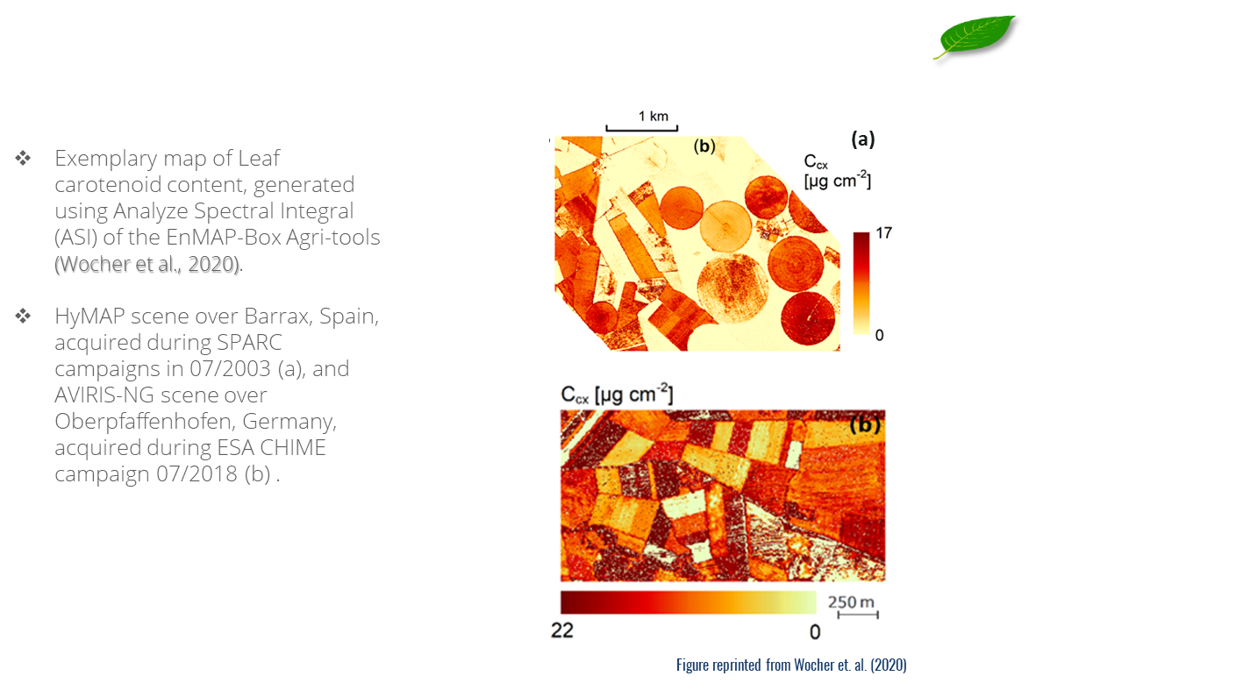
C_{xc} mapping example

Slide 55
Leaf anthocyanin content (C_{ant})

Slide 56
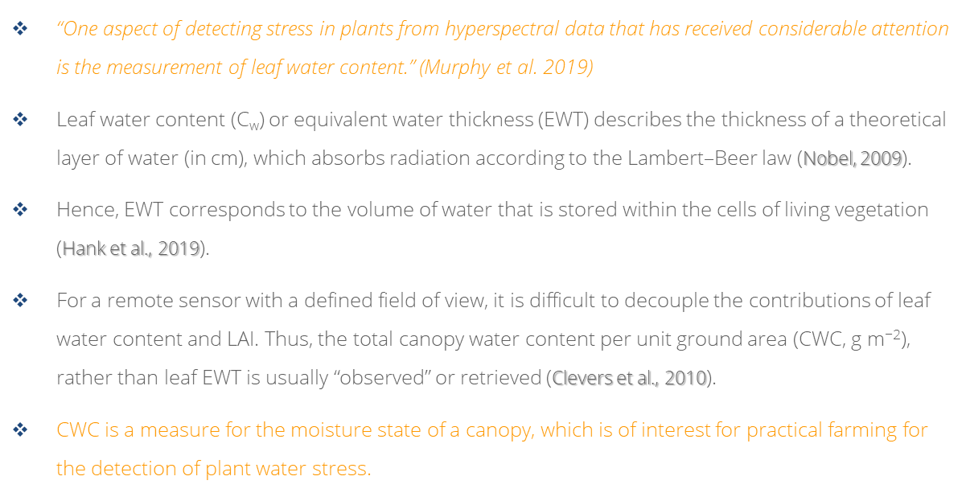
Leaf water content (C_{w} / EWT)

Slide 57
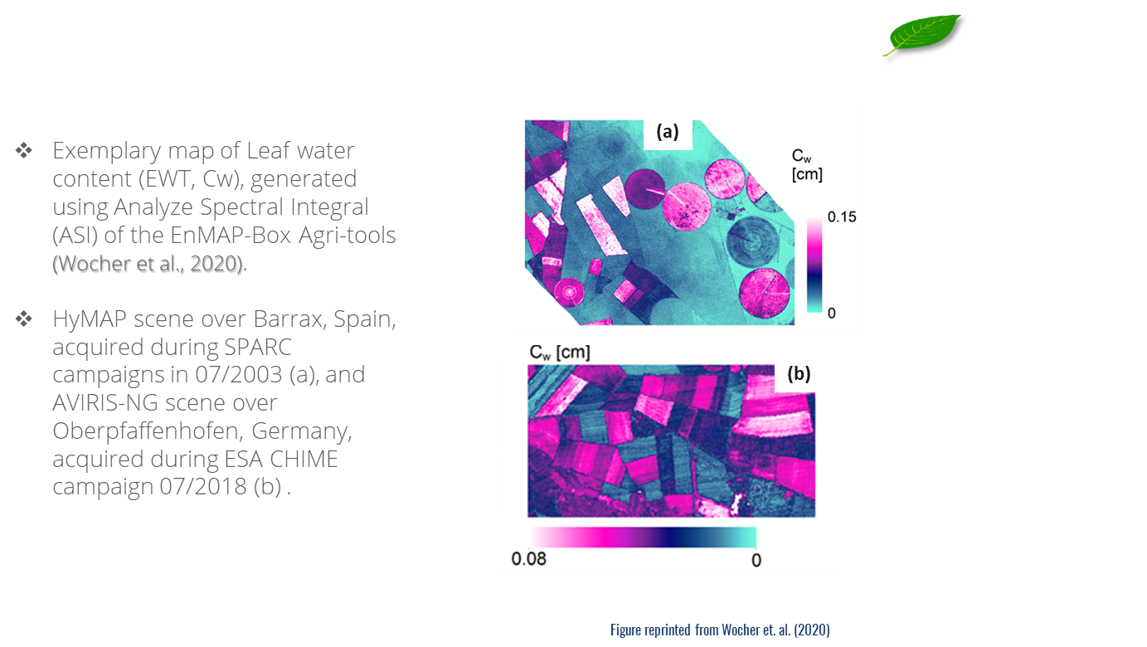
C_{w} mapping example

Slide 58
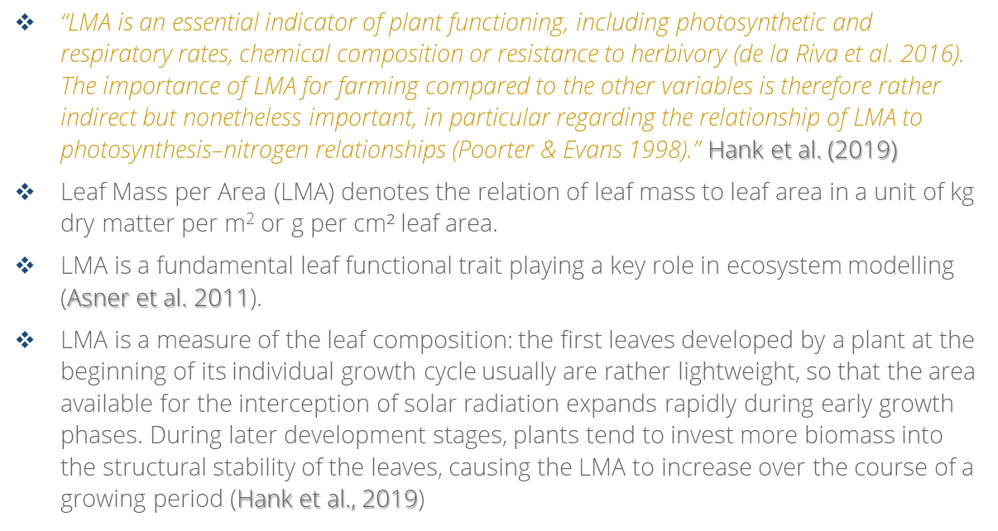
Leaf mass per area (LMA)

Slide 59
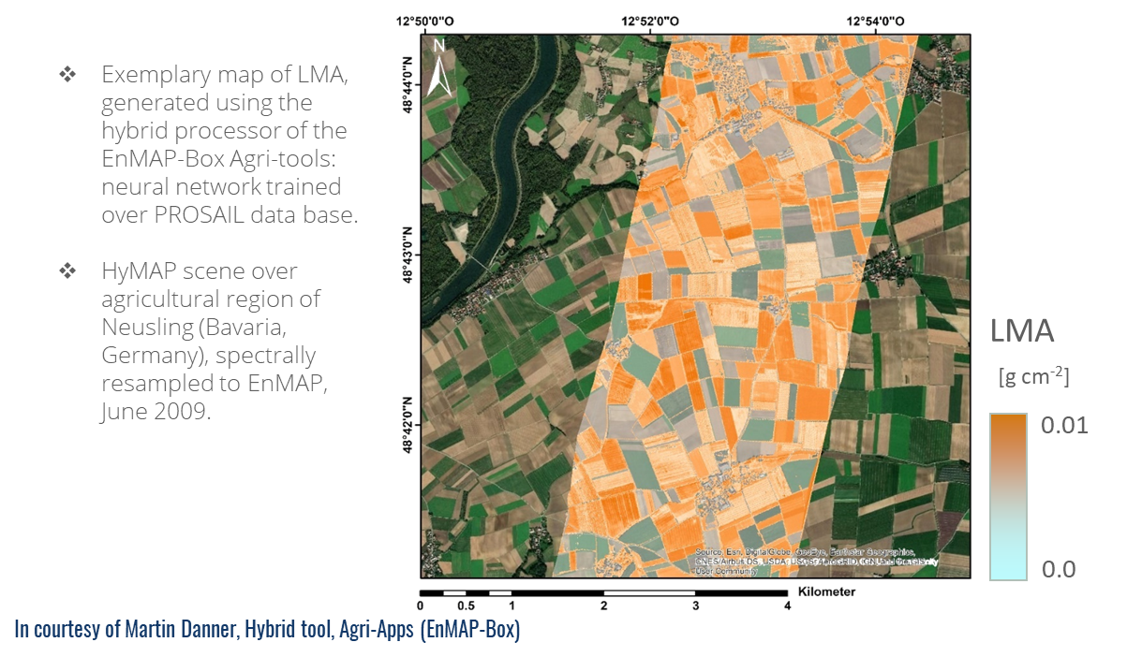
LMA mapping example

Slide 60
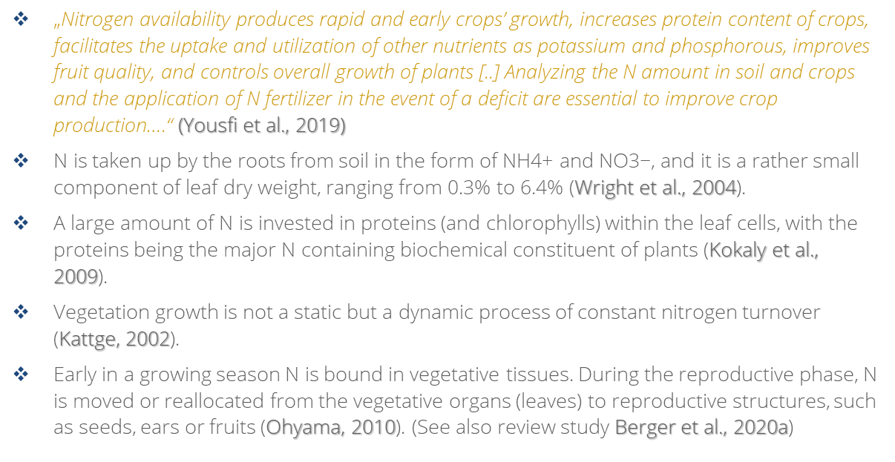
Leaf protein (Cp) / nitrogen content (N)

Slide 61
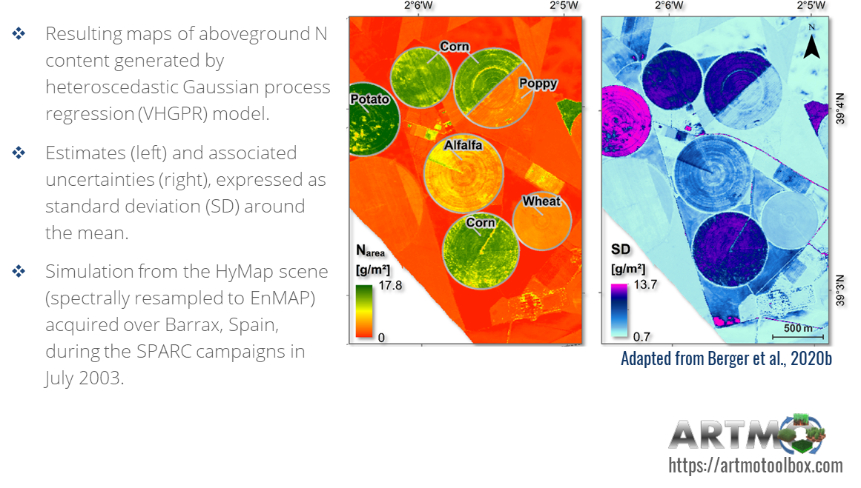
Canopy nitrogen content mapping

Slide 62
Credits
Brosinsky, T. Kuester, S. Foerster, H. Kaufmann, K. Segl, L. Guanter (2019). Principles of imaging spectroscopy - Electromagnetic radiation and its interactions with earth surface materials, slide collection, HYPERedu, EnMAP education initiative, August 2019, German Centre for Geosciences GFZ.
A. Brosinsky, M. Brell, S. Livens, K. Segl, T. Kuester, H. Kaufmann, L. Guanter, S. Foerster (2021). Imaging spectroscopy sensor technologies, slide collection, HYPERedu, EnMAP education initiative, March 2022, German Centre for Geosciences GFZ.
HyperEDU is funded within the EnMAP scientific preparation program under the DLR Space Administration with resources from the German Federal Ministry for Economic Affairs and Energy.

