Slide 1

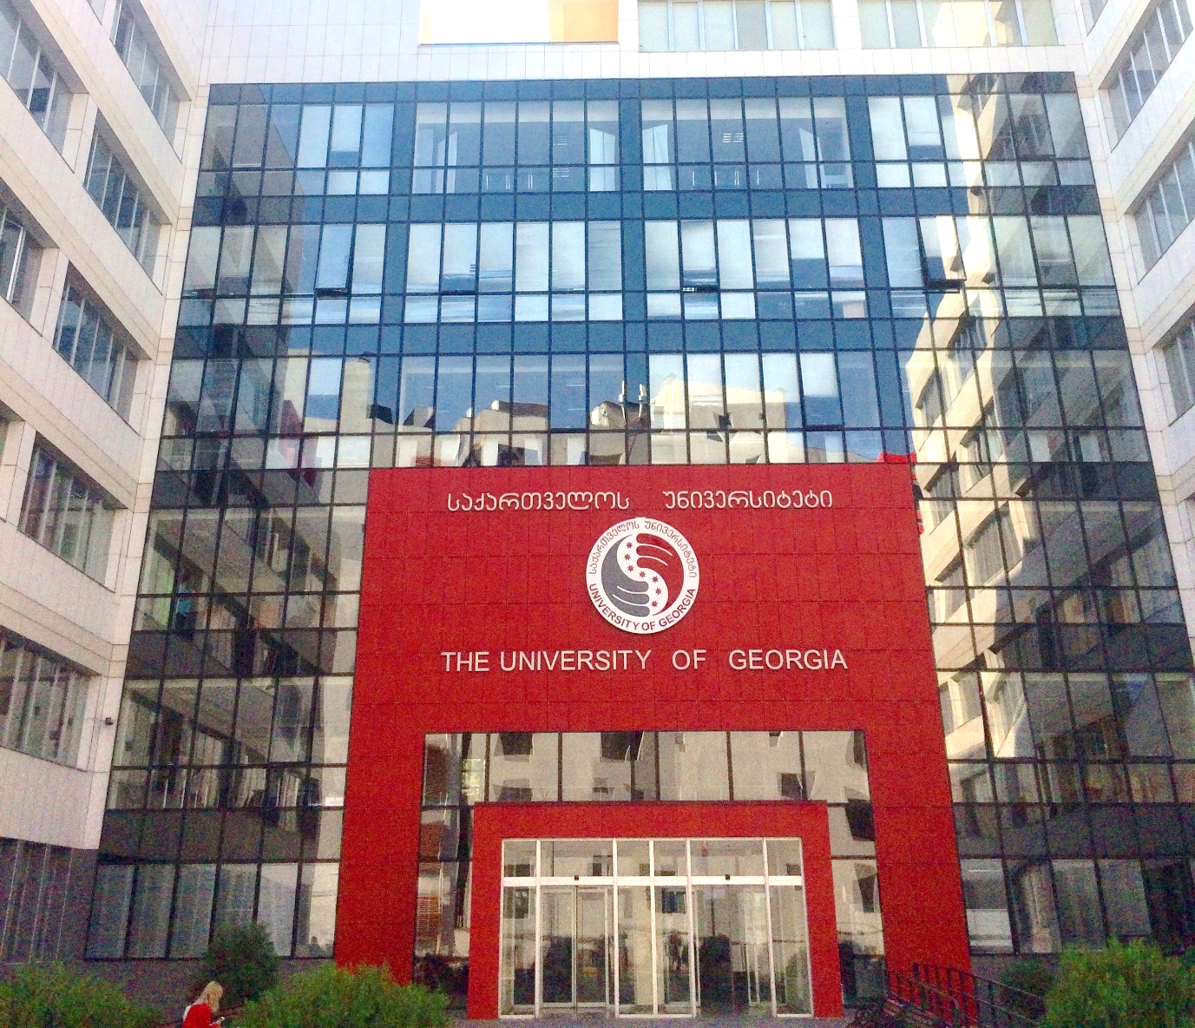
Modernization of Environment Protection Studies Programmes
for Armenia and Georgia
Summer School 2020
The University of Georgia
School of Science and Technologies

Slide 2
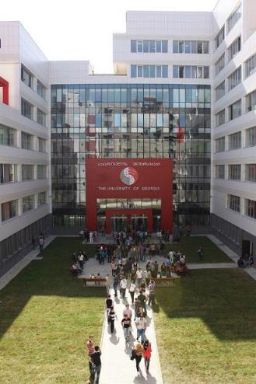
The University of Georgia (from 2004)
High quality education;
Modern teaching approaches;
Great variety of major and minor specialties;
Learning process in small working groups with local and foreign experts;
Exchange programs;
Modern Sports infrastructure and a fitness club;
Diverse student life, active and creative student clubs;
High-tech, modern laboratories;
Unforgettable events;
International certificate programs.

Slide 3
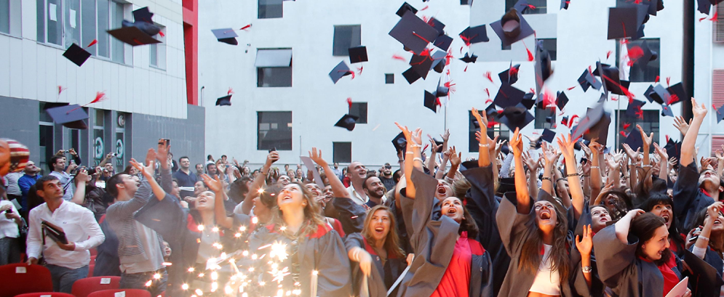

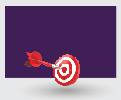




School of Humanities
School of Business
School of Social Sciences
School of Law
School of Health Sciences
School of Science and Technology
6600 active student
2000 international students
450 engineering student
200 international students

Slide 4
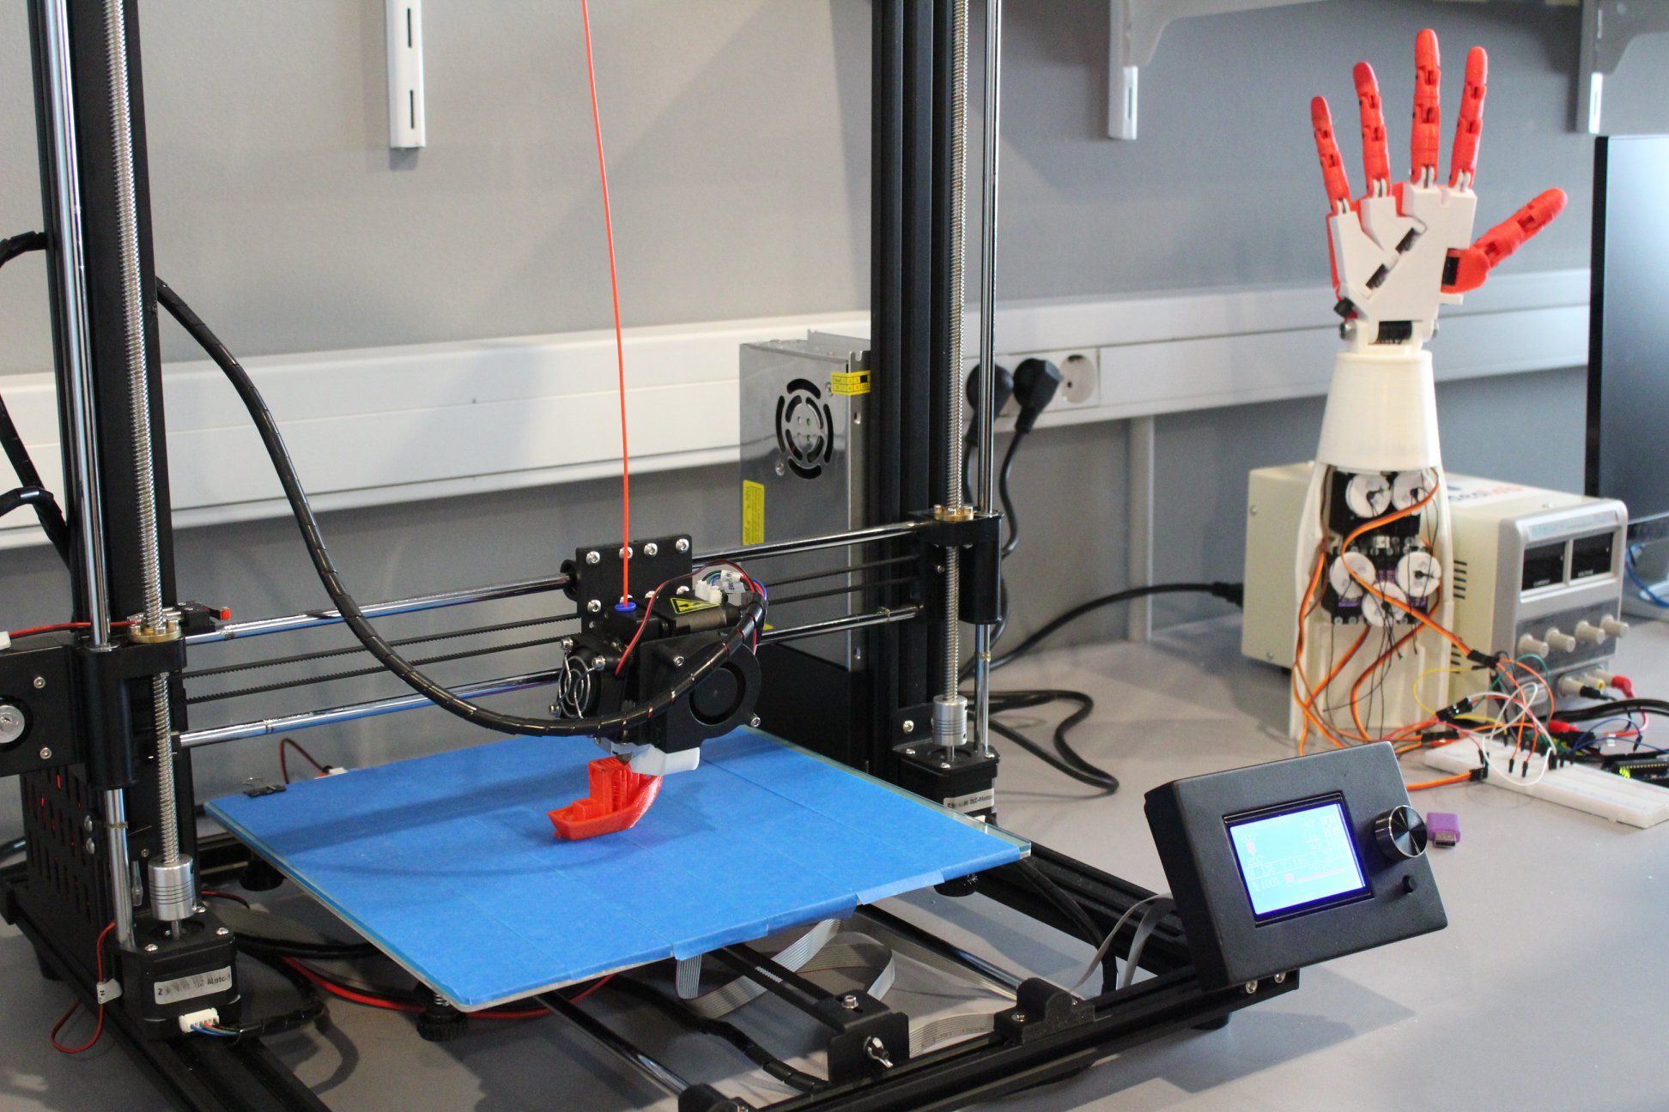
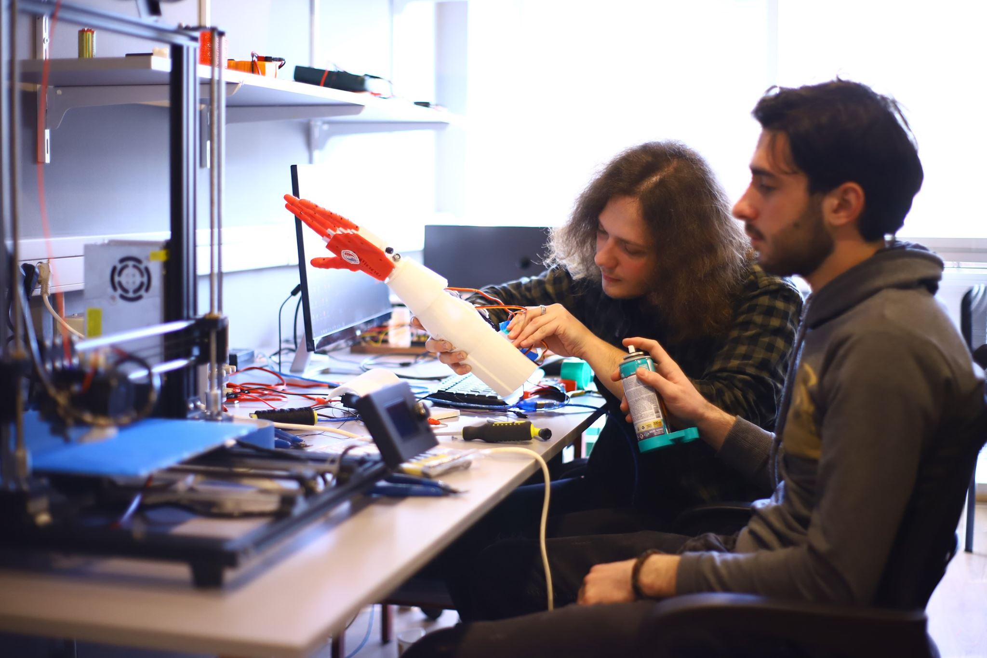
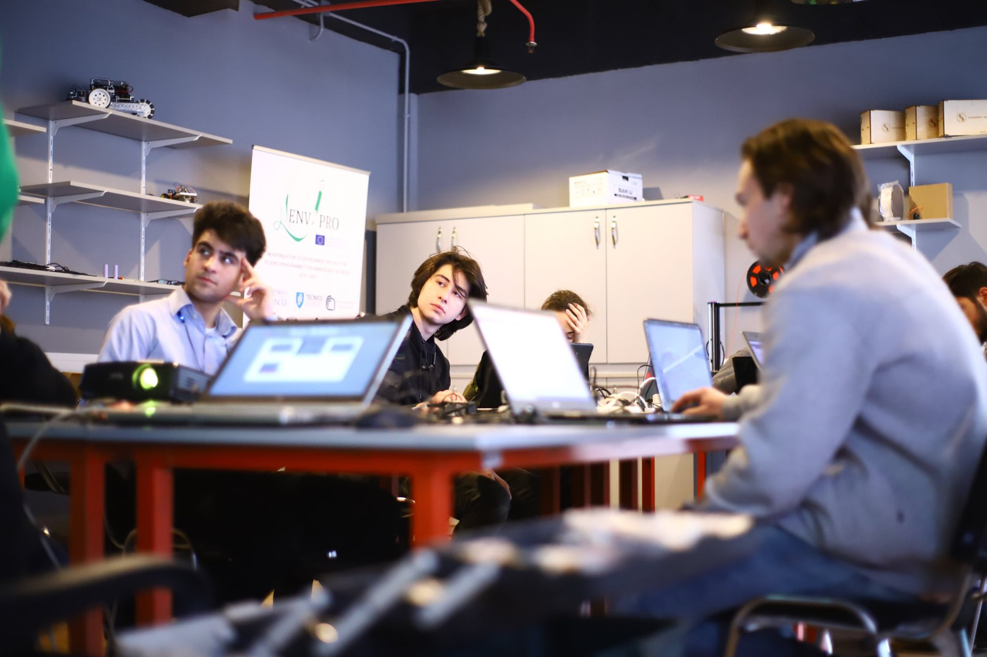
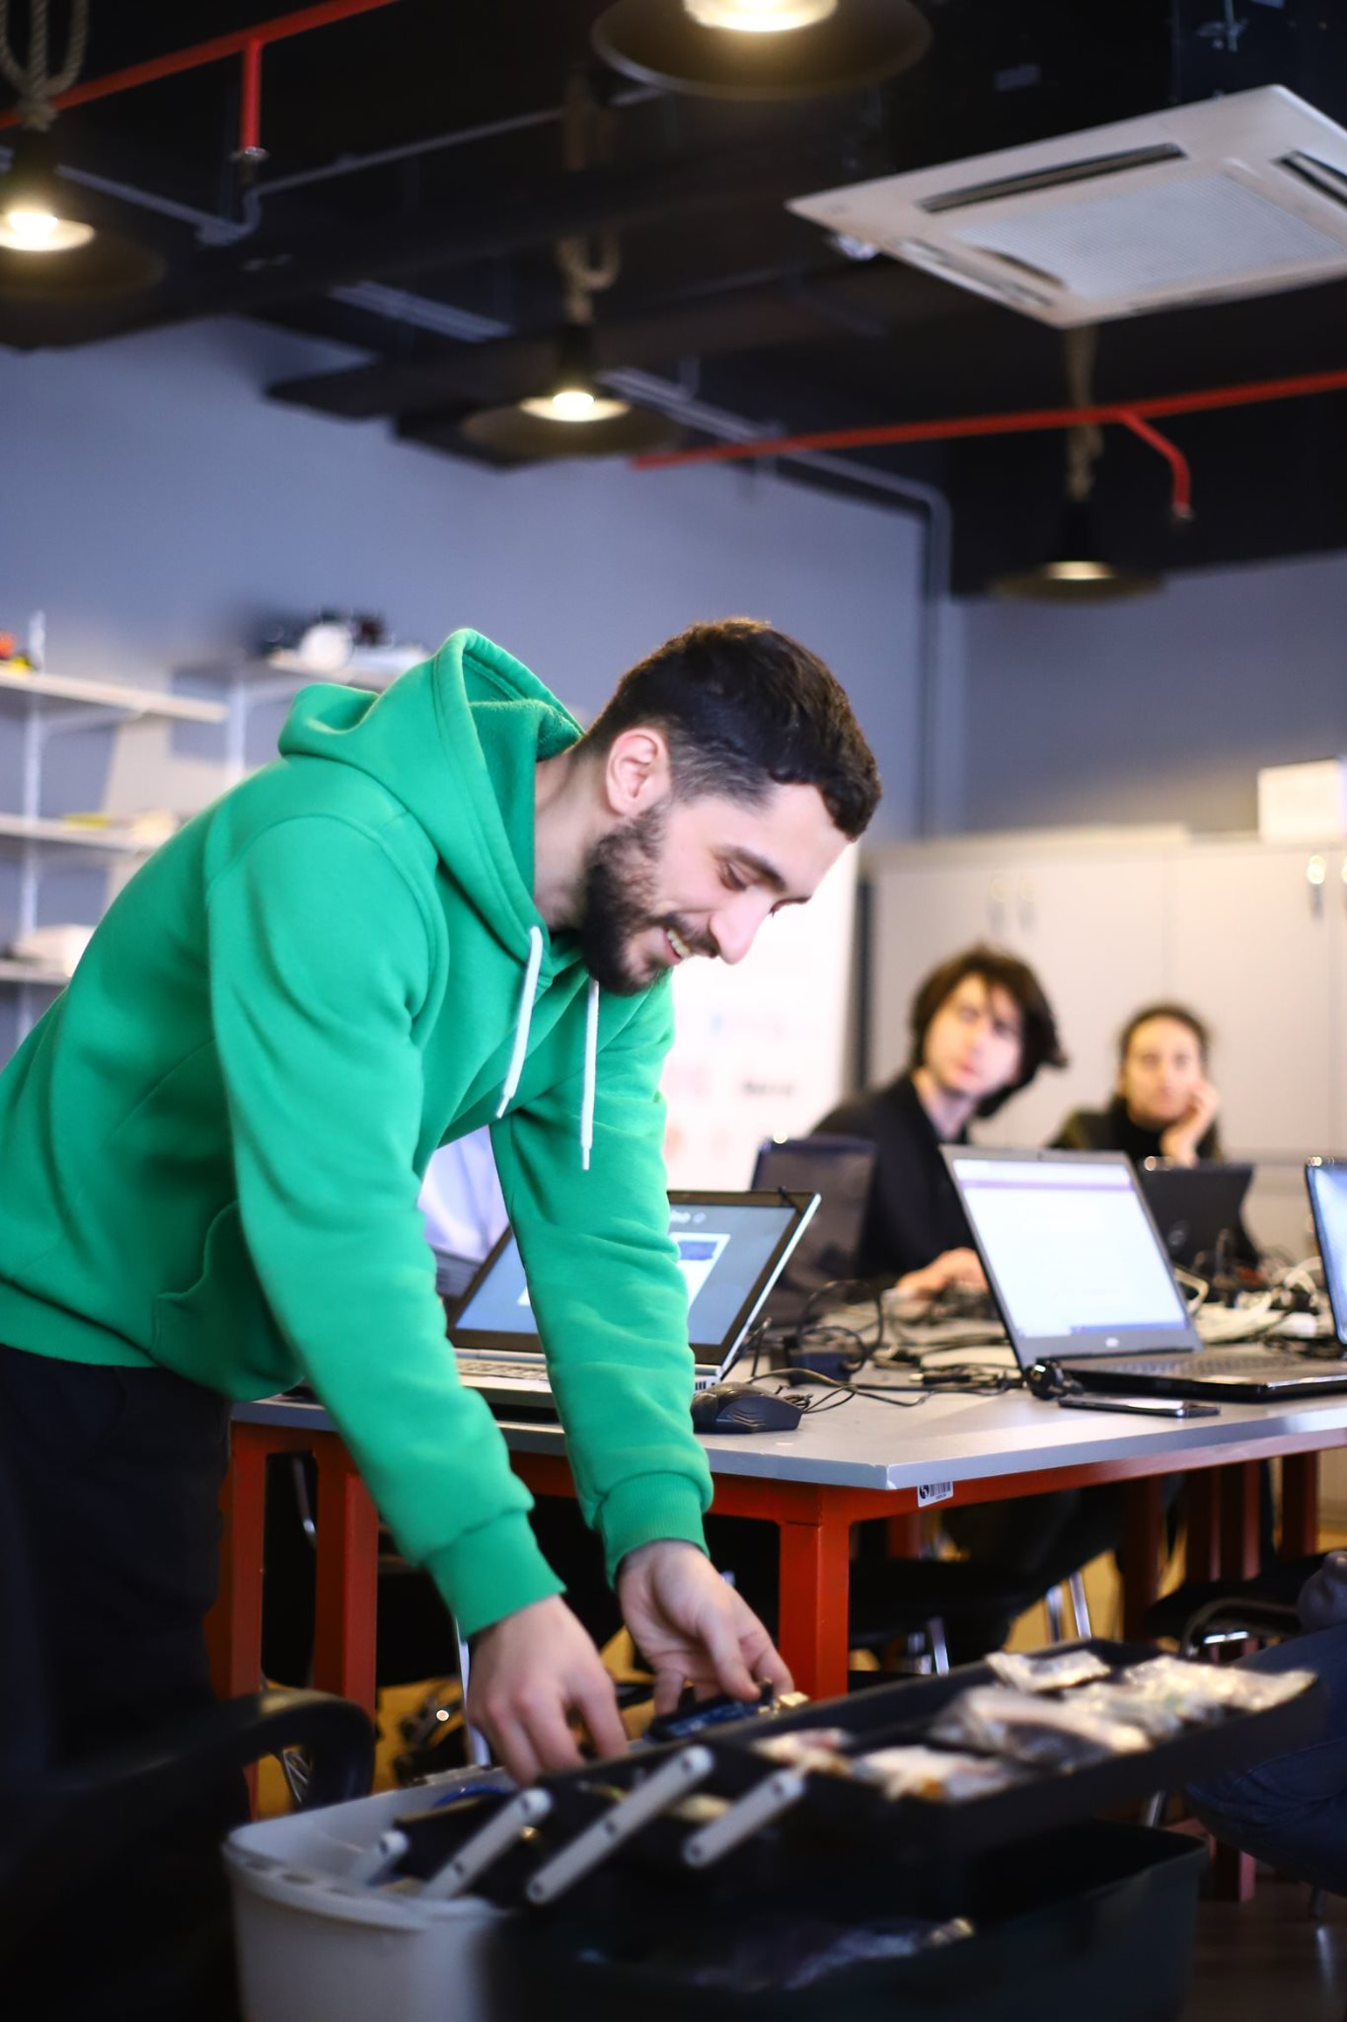
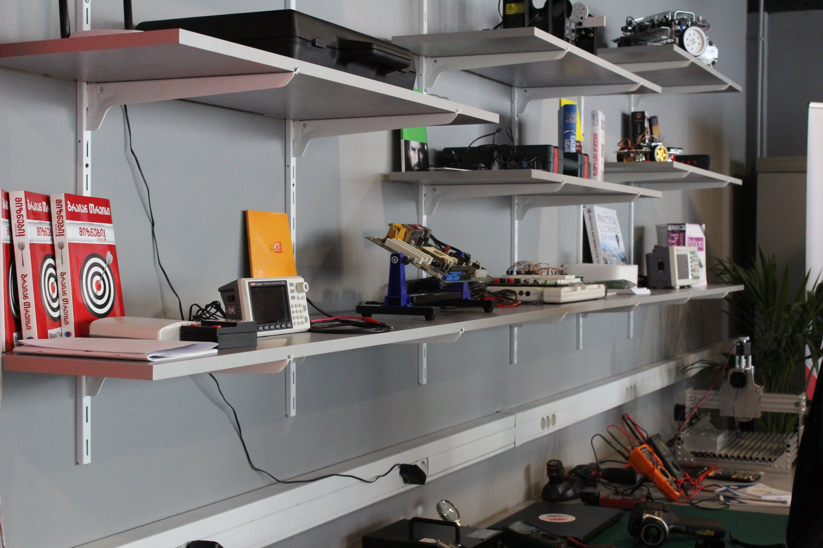
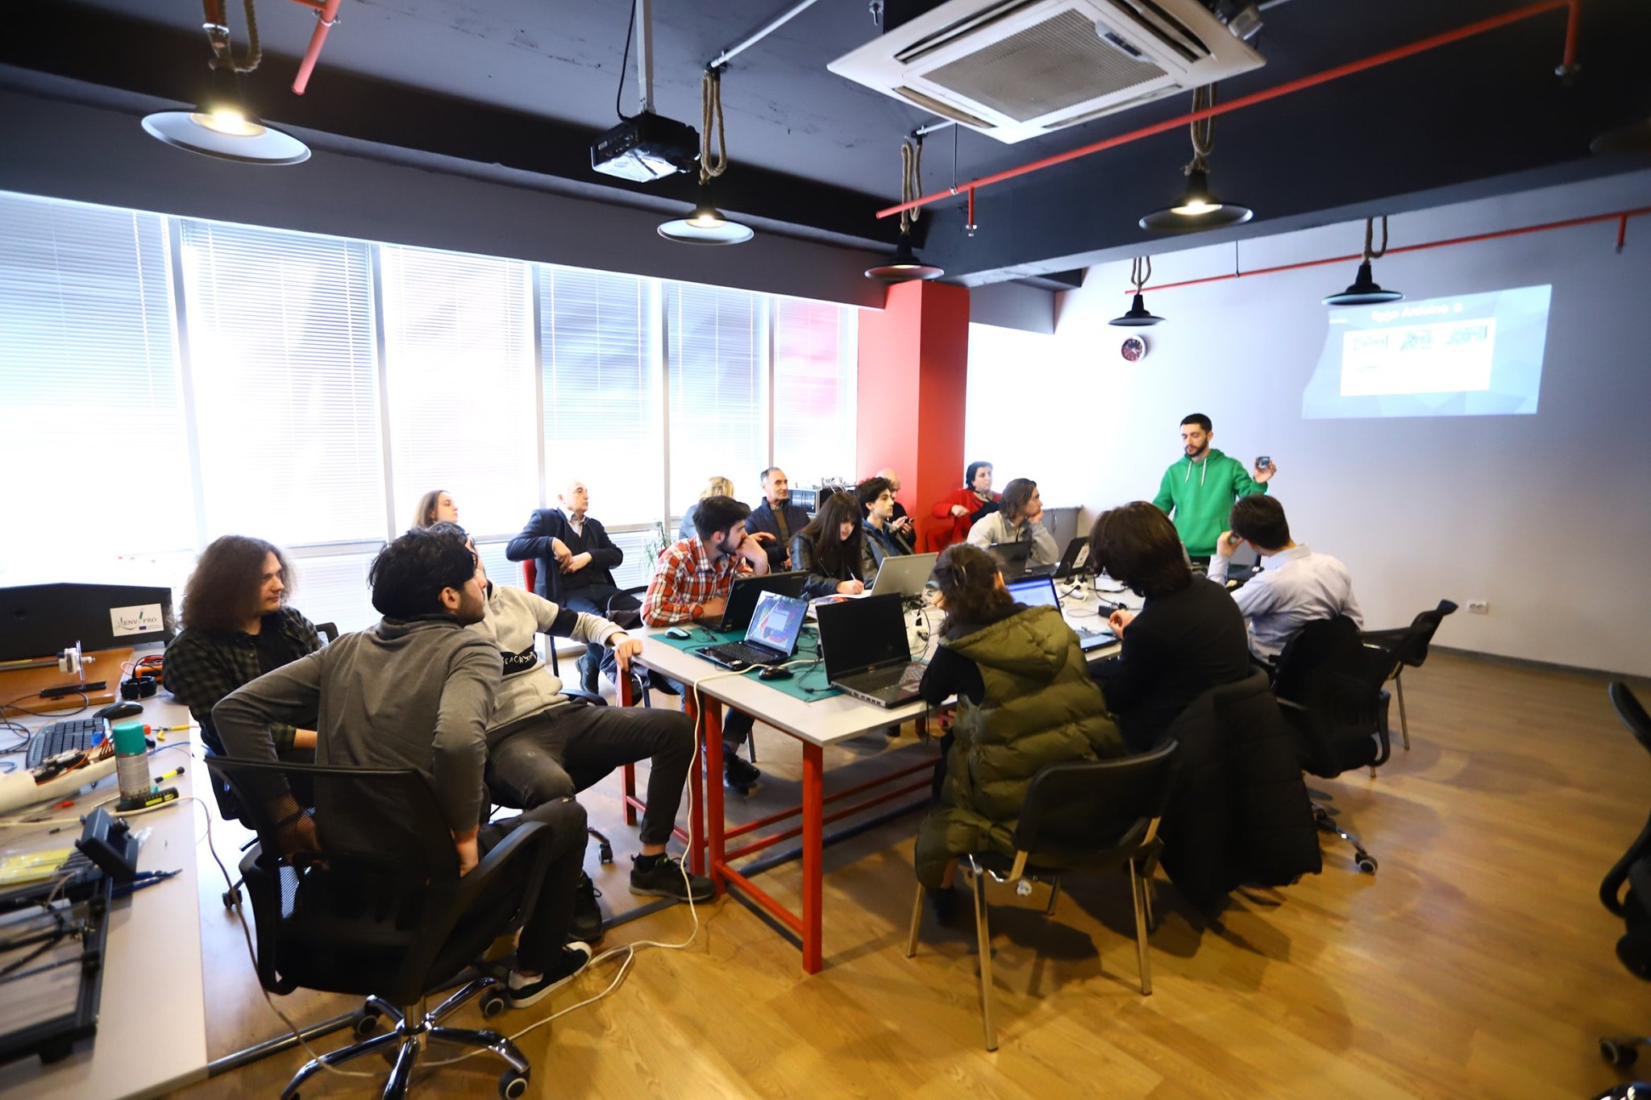
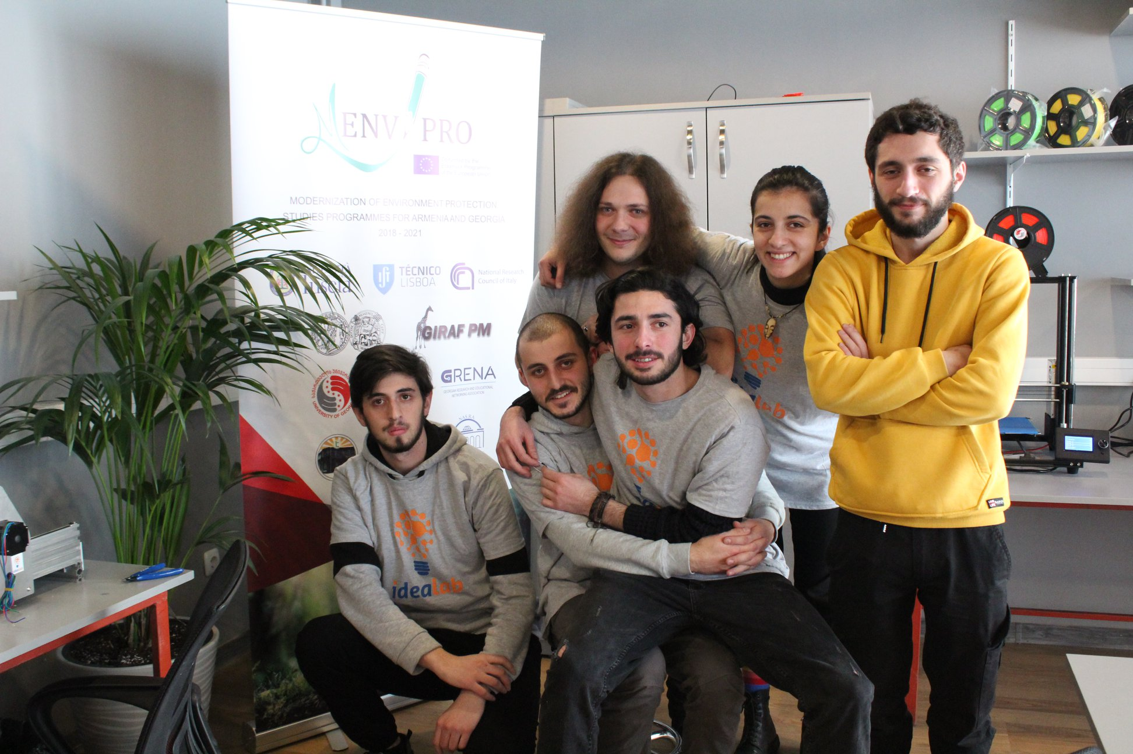
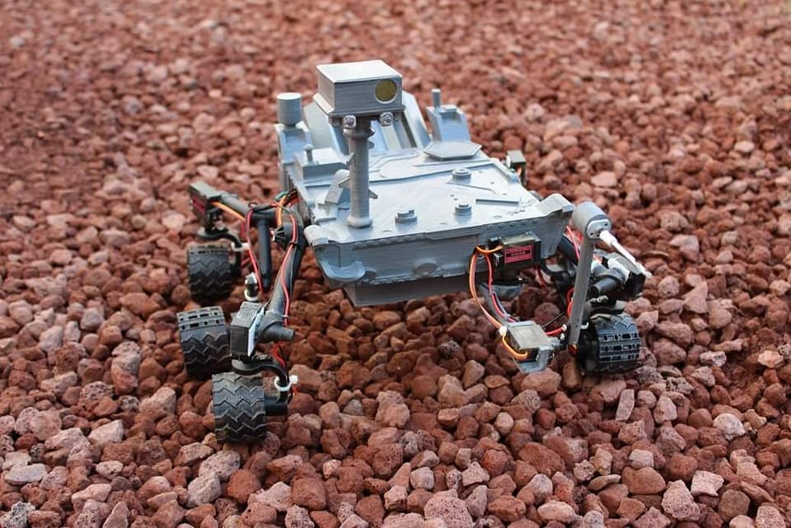

Idealab is a space where all interested young people and students can come up with an interesting idea and use modern technologies to implement it.
The lab has a convenient workspace. It is equipped with modern equipment and inventory of electronic engineering such as 3D printer, laser cutter, CNC machine, oscilloscope, signal generators, multimeters, Arduino and Raspberry modules, various types of sensors.

