Slide 1
6 – 13 September 2021

Slide 2
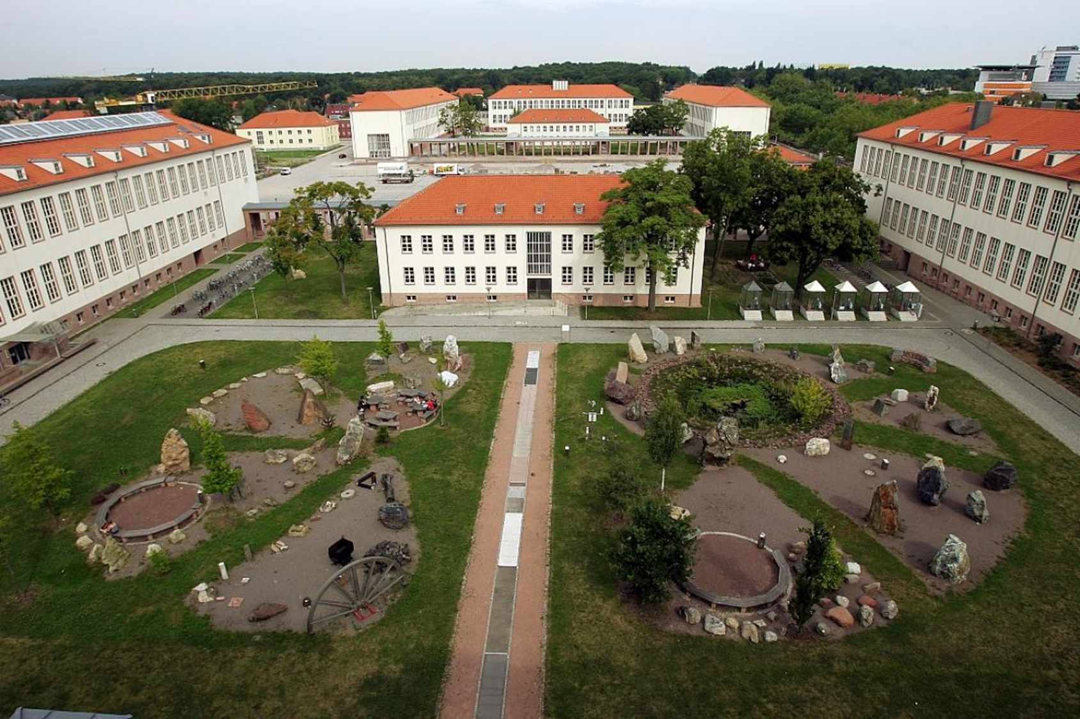
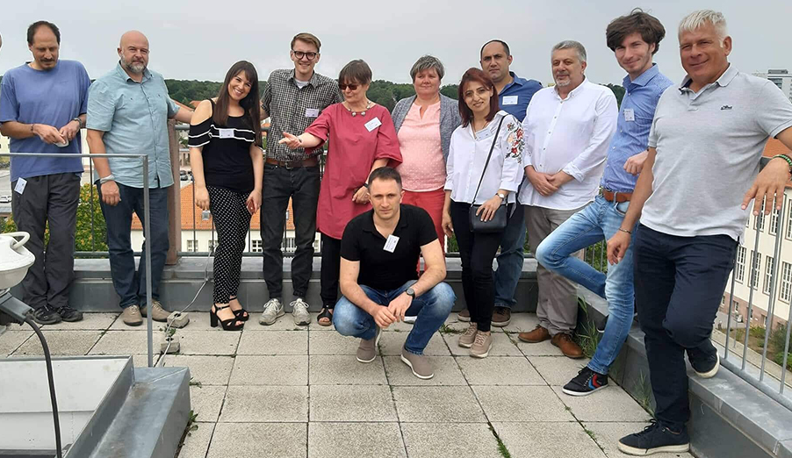
Martin Luther University Halle-Wittenberg Germany
Institute of Geosciences and Geography

Slide 3
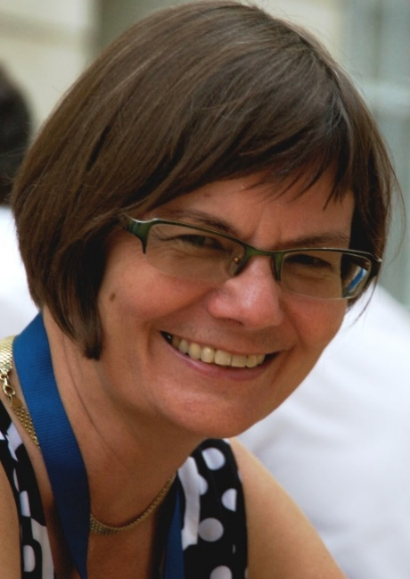
Prof. Dr. Cornelia Gläßer
Dr. Michael Denk
Education in Geography and Geosciences
PhD and Habilitation in multi and hyperspectral remote sensing
Active in leading of national and international scientific organisations
Research interests:
• hyperspectral remote sensing für geo-, hydro- and biochemical parameter in different landscape types and climatic regions
• Environmental Remote sensing of mining areas and whole mine cycle
• Phenology of crops and natural phenology
• Long term experiences in Elearning and eAssessment
Study of Geography at the MLU Halle-Wittenberg
PhD in spectroscopy of industrial bypropducts
Research interests:
Hyperspectral and multispectral remote sensing
Visible light to the longwave infrared spectroscopy
Exploration of anthropogenic deposits
Spectroscopy of soils, rocks & man made materials

Slide 4
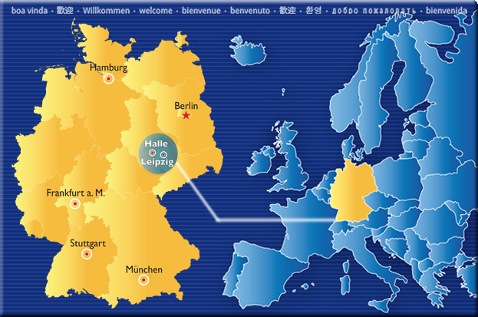
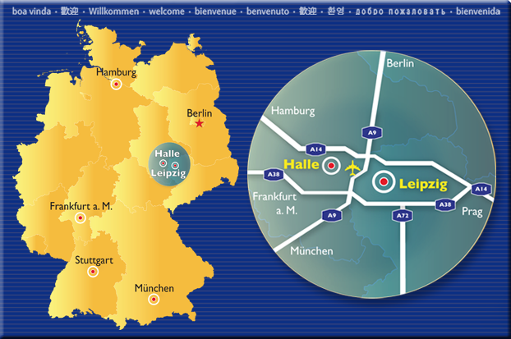
Martin Luther University Halle-Wittenberg
Federal State Saxony-Anhalt
Halle/Saale – Central Site in Germany and
Europe
General facts:
largest city in Saxony-Anhalt
population: ~240.000, density
Long history in industry ( mining, chemistry,
engine building, food and others), science and art
Today:
Commerce and industry, Services,
Biochemistry, Biotechnology, Pharmacy
Compur Science, creative industry
Science and Resarch
Max Planck Instutes - Basic Research
Fraunhofer Institutes – Applied Resaerch
Helmholtz Association Environmentel Research Center
Leibnitz Institute
Marti Luther University
Universit of Art and Design Burg Giebichenstein
Expo Real

Slide 5
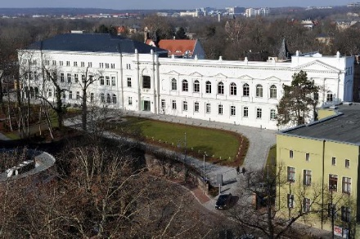
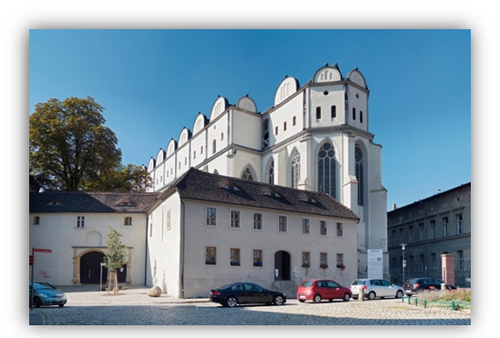
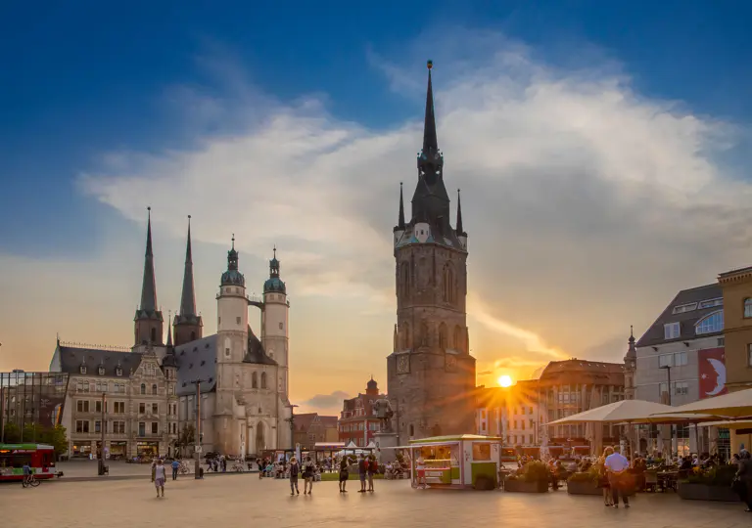
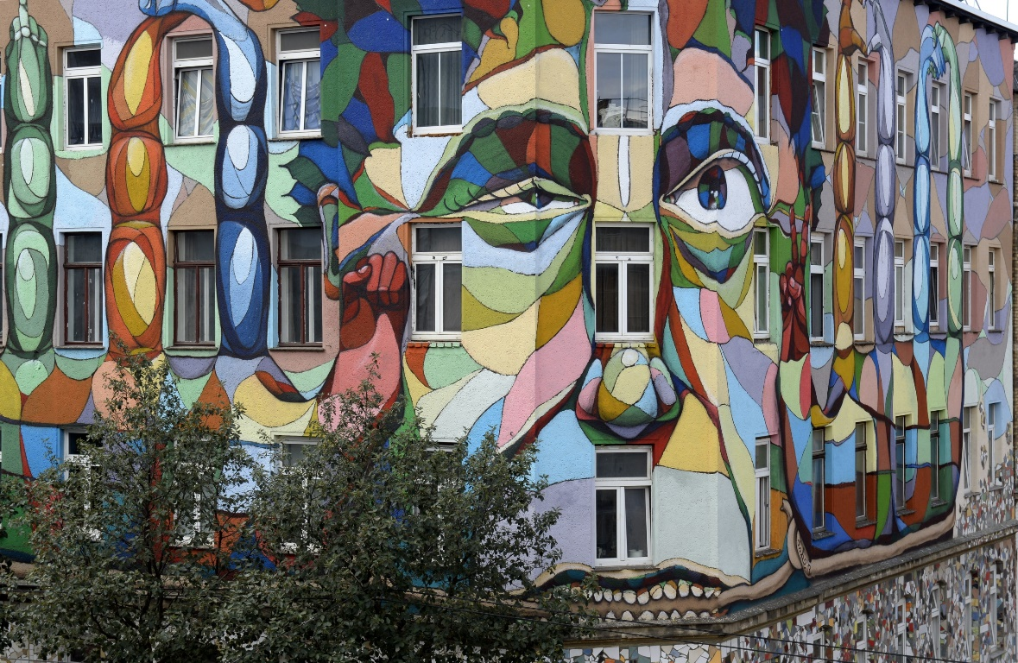
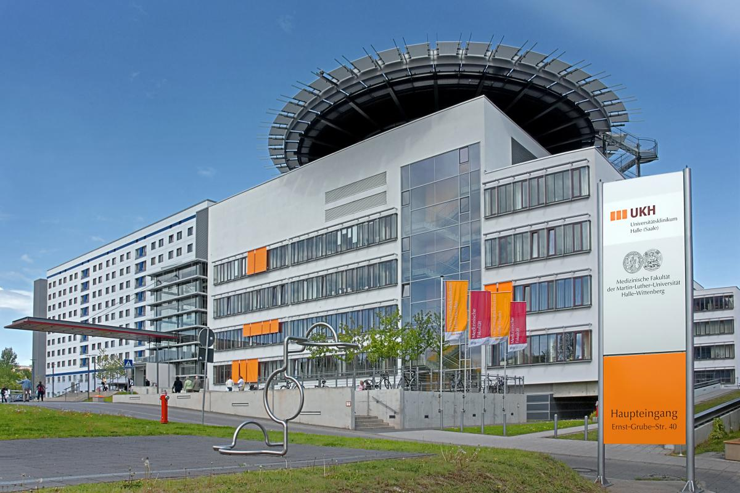
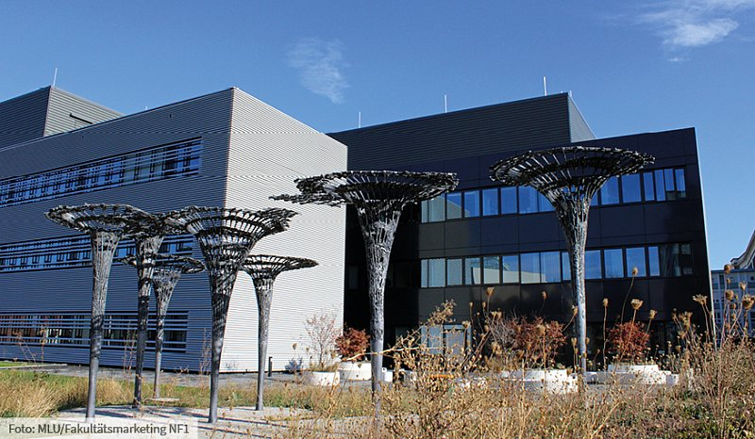
Author: Sicherlich, URL: http://upload.wikimedia.org/wikipedia/commons/3/3e/2007-07_Halle_%28Saale%29_24.jpg
The Martin Luther University Halle-Wittenberg

Slide 6
Structure of the University
Theology
Law, Economics and Business
Medicine
Philosophy I
MLU
Halle-Wittenberg
Philosophy II
Institute of Computer Science
Philosophy III
Natural Sciences I
Institute for Agricultural and Nutritional Sciences
Natural Sciences II
Natural Sciences III
Center of Engineering Sciences
Institute of Geosciences and Geography

Slide 7
Structure Study Programme
Bachelor (180 ETCS)
Applied Geosciences
Natural Ressource Management
Master (120 ETCS)
Geography
Applied Geosciences
Natural Ressource Management
Geography
Teaching (state examination)
Geography
International Area Studies/Global Change
Master
(394 Students)*

Slide 9
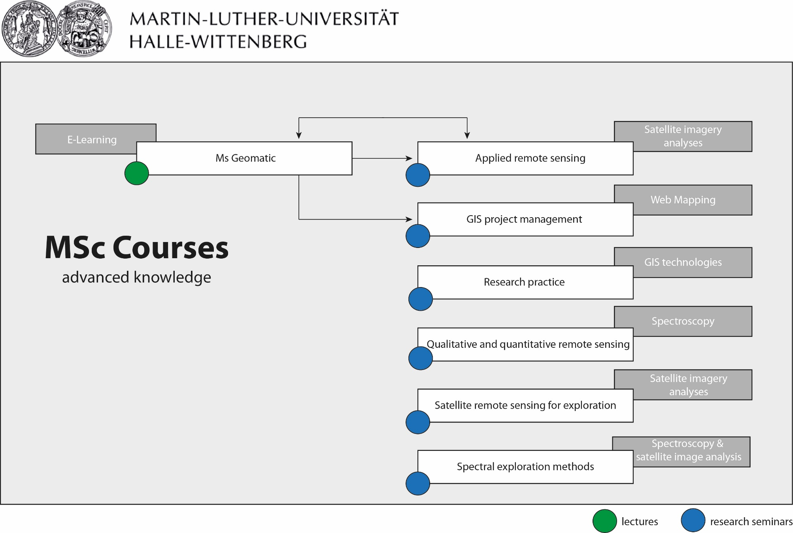

Slide 10
Thank you for your kind attention!

